Slide 1

Introduction to Circuits

Slide 2
What does Codasign do?

Slide 3
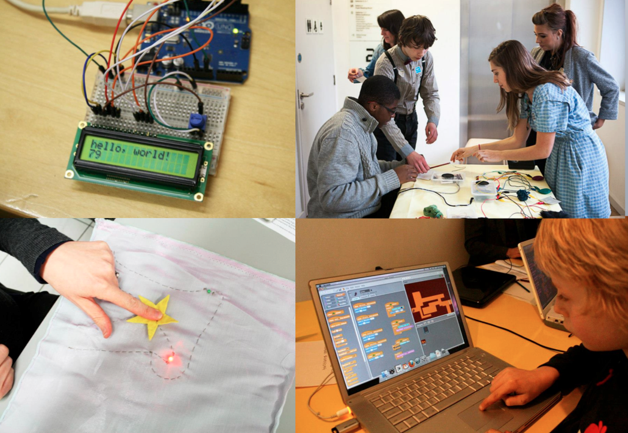

Slide 4
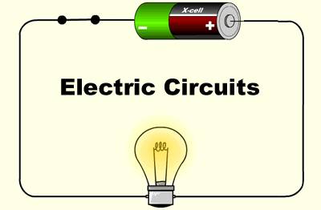
Arduino diagram1

Slide 5

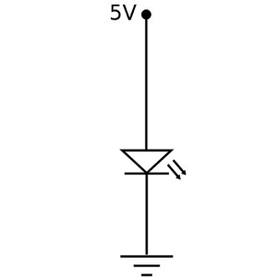
Arduino diagram1

Slide 6
Let’s make pencil and paper circuits
Arduino diagram1

Slide 7
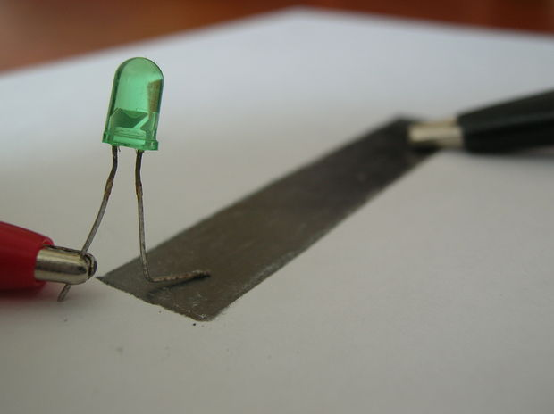
Arduino diagram1
Variable Resistor
Notes:
Pencil variable resistor

Slide 8
Arduino diagram1
How does it work?
Notes:
Pencil variable resistor

Slide 9
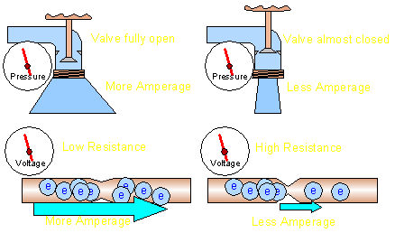
Change Resistance
All else being equal, if there is an increase in resistance, the current flow will be reduced.
Notes:
Pencil variable resistor

Slide 10
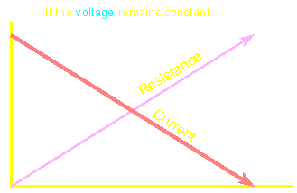
Arduino diagram1
More Resistance =
Less Current
the current flow is inversely proportional to the resistance in the circuit.
Notes:
Pencil variable resistor

Slide 11
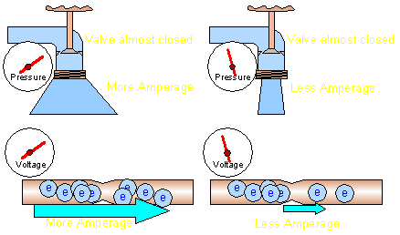
Arduino diagram1
Change Voltage
All else being equal, increased voltage causes an increase in current
Notes:
Pencil variable resistor

Slide 12
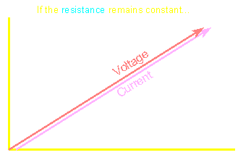
Arduino diagram1
More Voltage = More Current
the current flow is directly proportional to the voltage applied to the resistance.
Notes:
Pencil variable resistor

Slide 13
Let’s make pencil and paper Flashlight
Arduino diagram1

Slide 14

Arduino diagram1

Slide 16
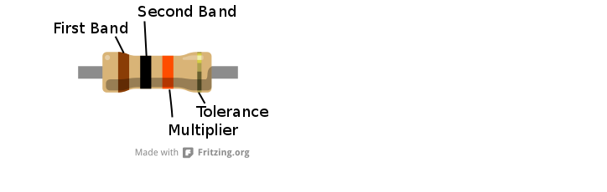
Resistor
They reduce the current that flows across them and are
useful for making sure other components aren't overloaded
with too much current.

Slide 17
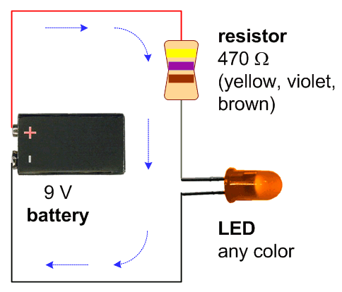
Arduino diagram1

Slide 18
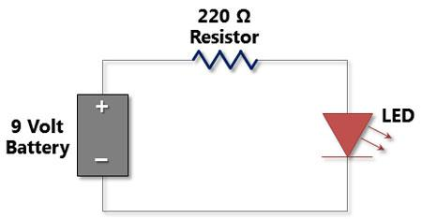
Arduino diagram1

Slide 19
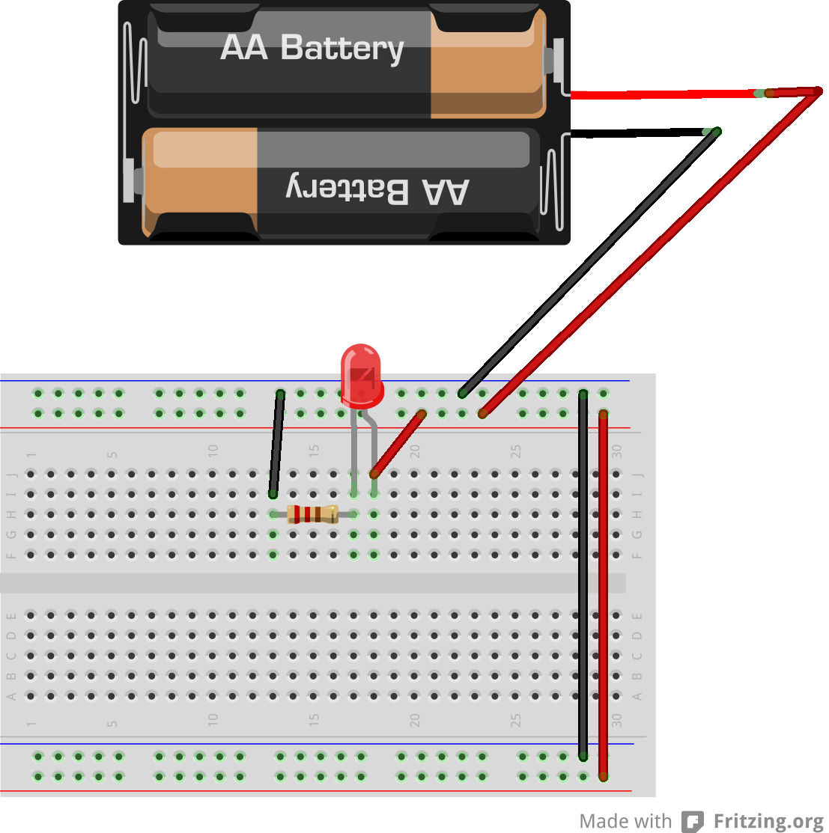
Arduino diagram1

Slide 20
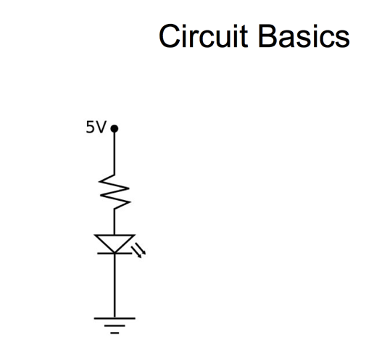

Slide 21
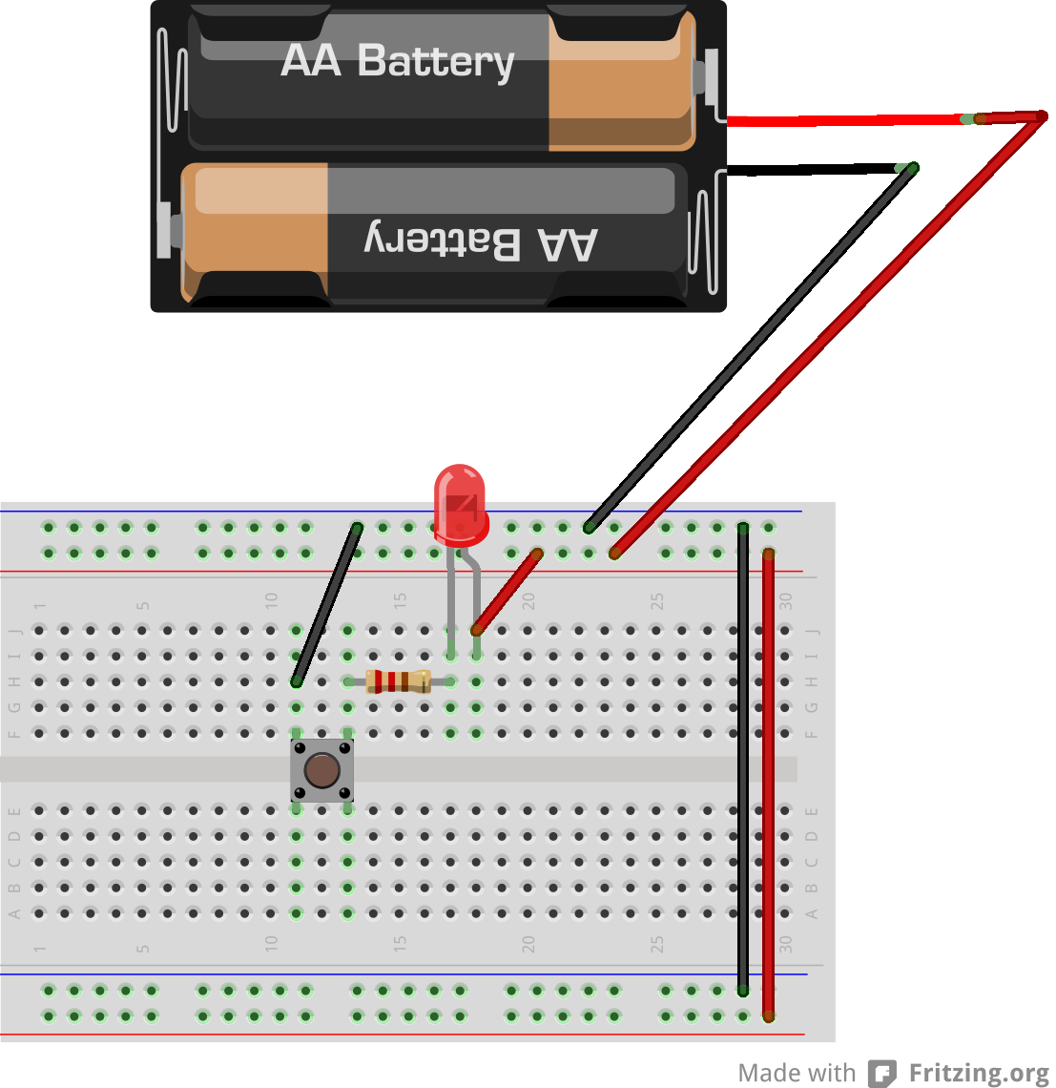
Arduino diagram1

Slide 22
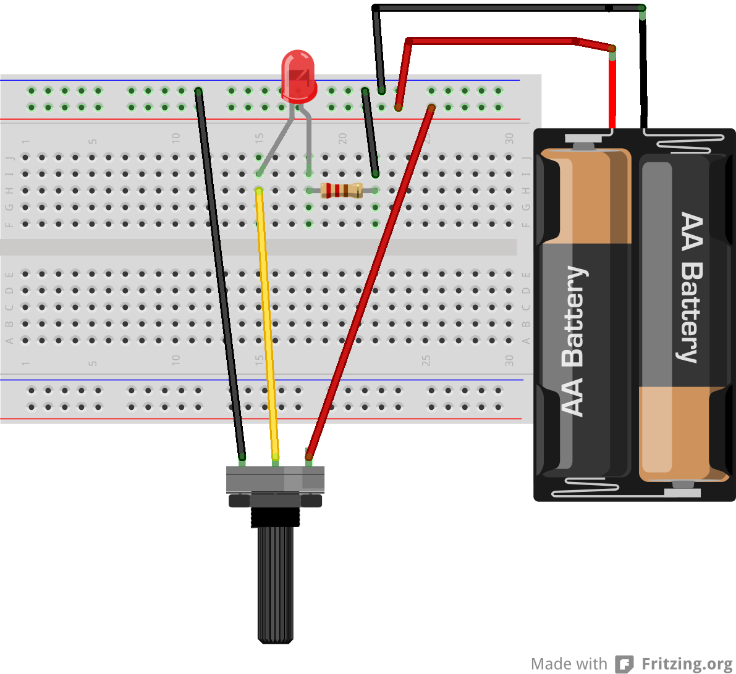
Arduino diagram1

Slide 23
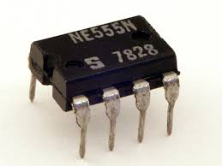
Arduino diagram1
555 Timer Chip

Slide 24
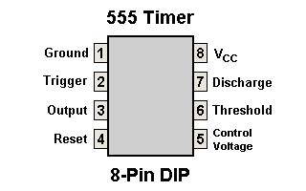
Arduino diagram1
555 Timer Chip

Slide 25
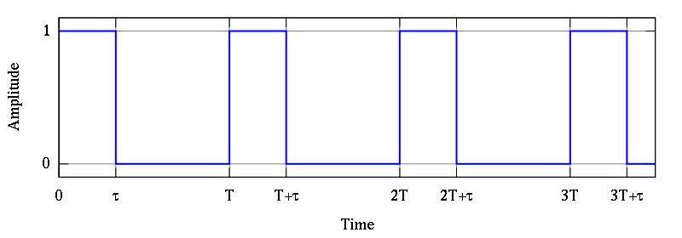
Arduino diagram1
Pulse waveform
The 555 timer is a chip that can be used to create pulses of various durations

Slide 26
Arduino diagram1
What is it good for?
The 555 timer is a chip that can be used to create pulses of various durations
a steady clock to keep time in a circuit (astable mode)
a very basic noise maker
time delay for an incoming signal (monostable mode)

Slide 27
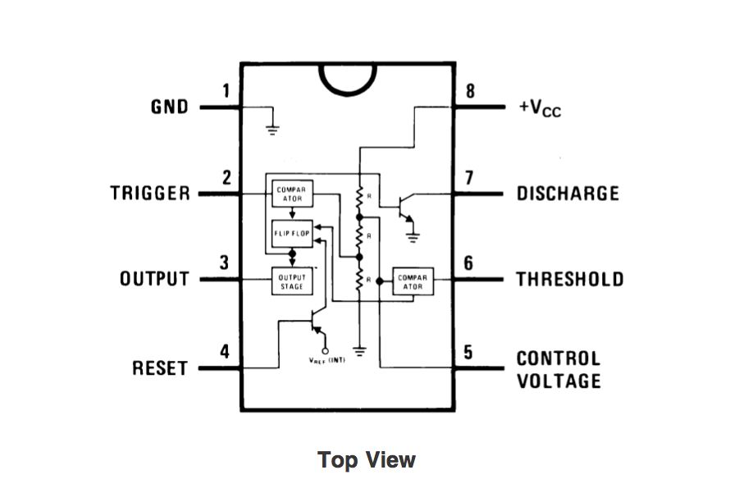
Arduino diagram1
555 Timer Chip
Flip Flop

Slide 28

Monostable Mode Circuit
Monostable Mode is great for creating time delays.

Slide 29
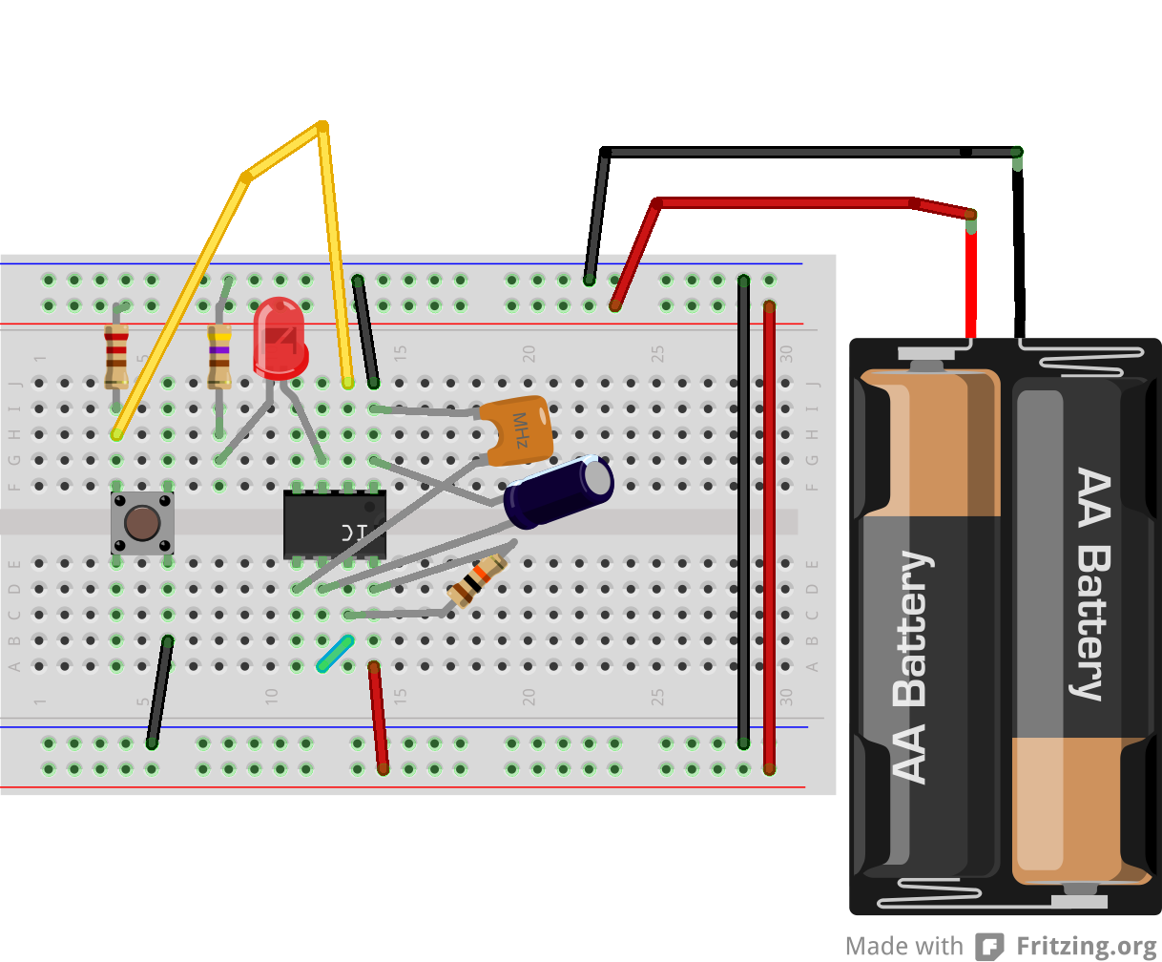
Monostable Mode Circuit

Slide 30
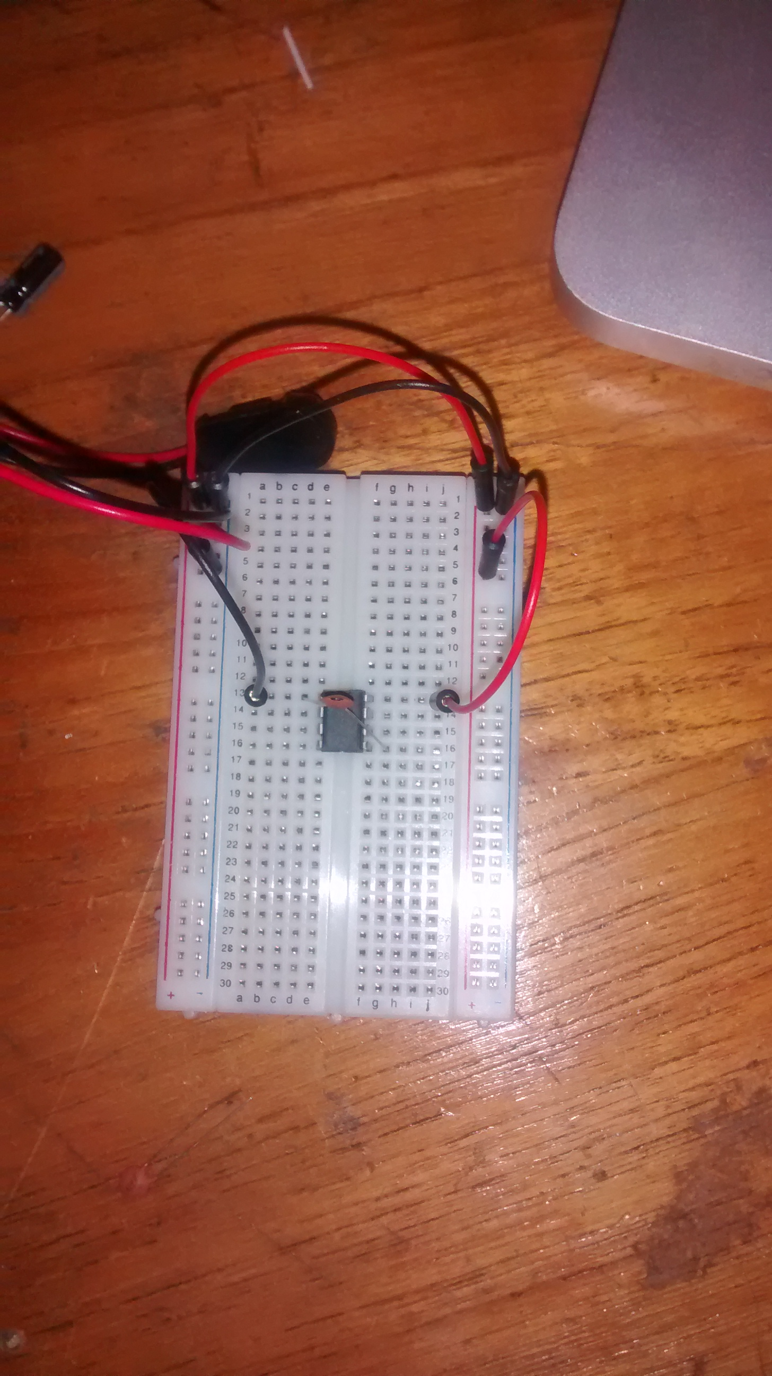
Monostable Mode Circuit

Slide 31
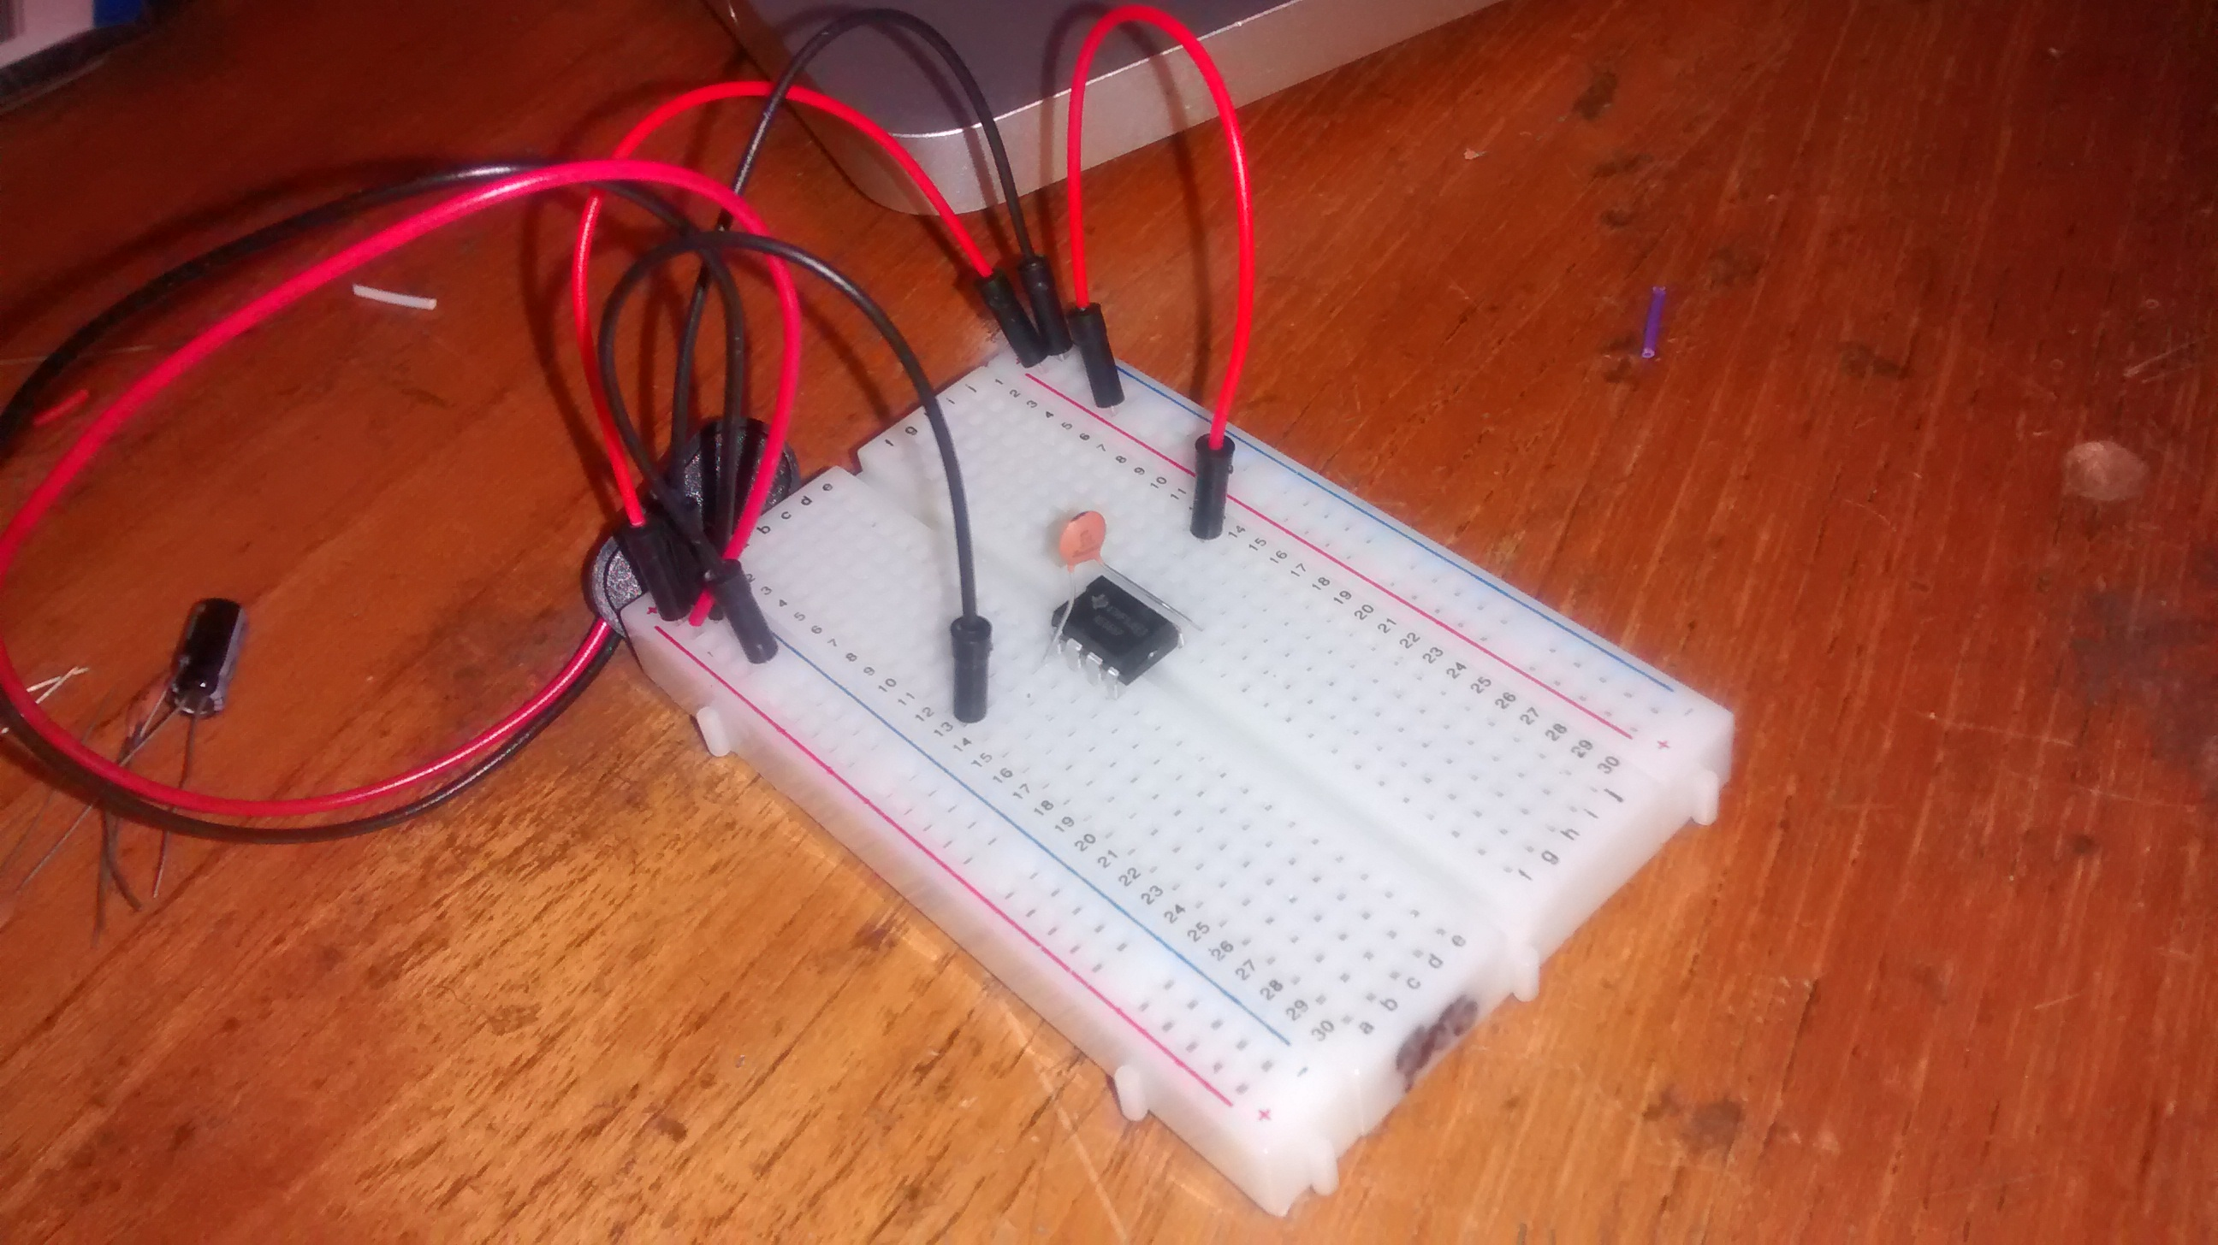
Connect power and ground to pins 8 and 1 of the 555 timer (red and black wires)

Slide 32
connect a 0.01uF capacitor between pins 5 and 1.

Slide 33
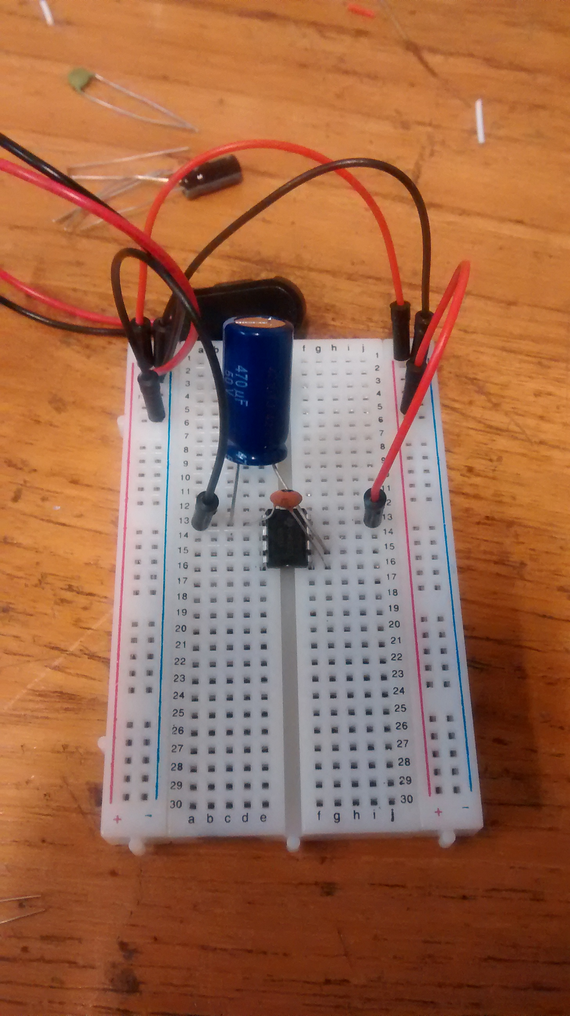
Connect a 440uF capacitor between pins 1 and 6
make sure that the negative lead of the capacitor is connected to pin 1.

Slide 34
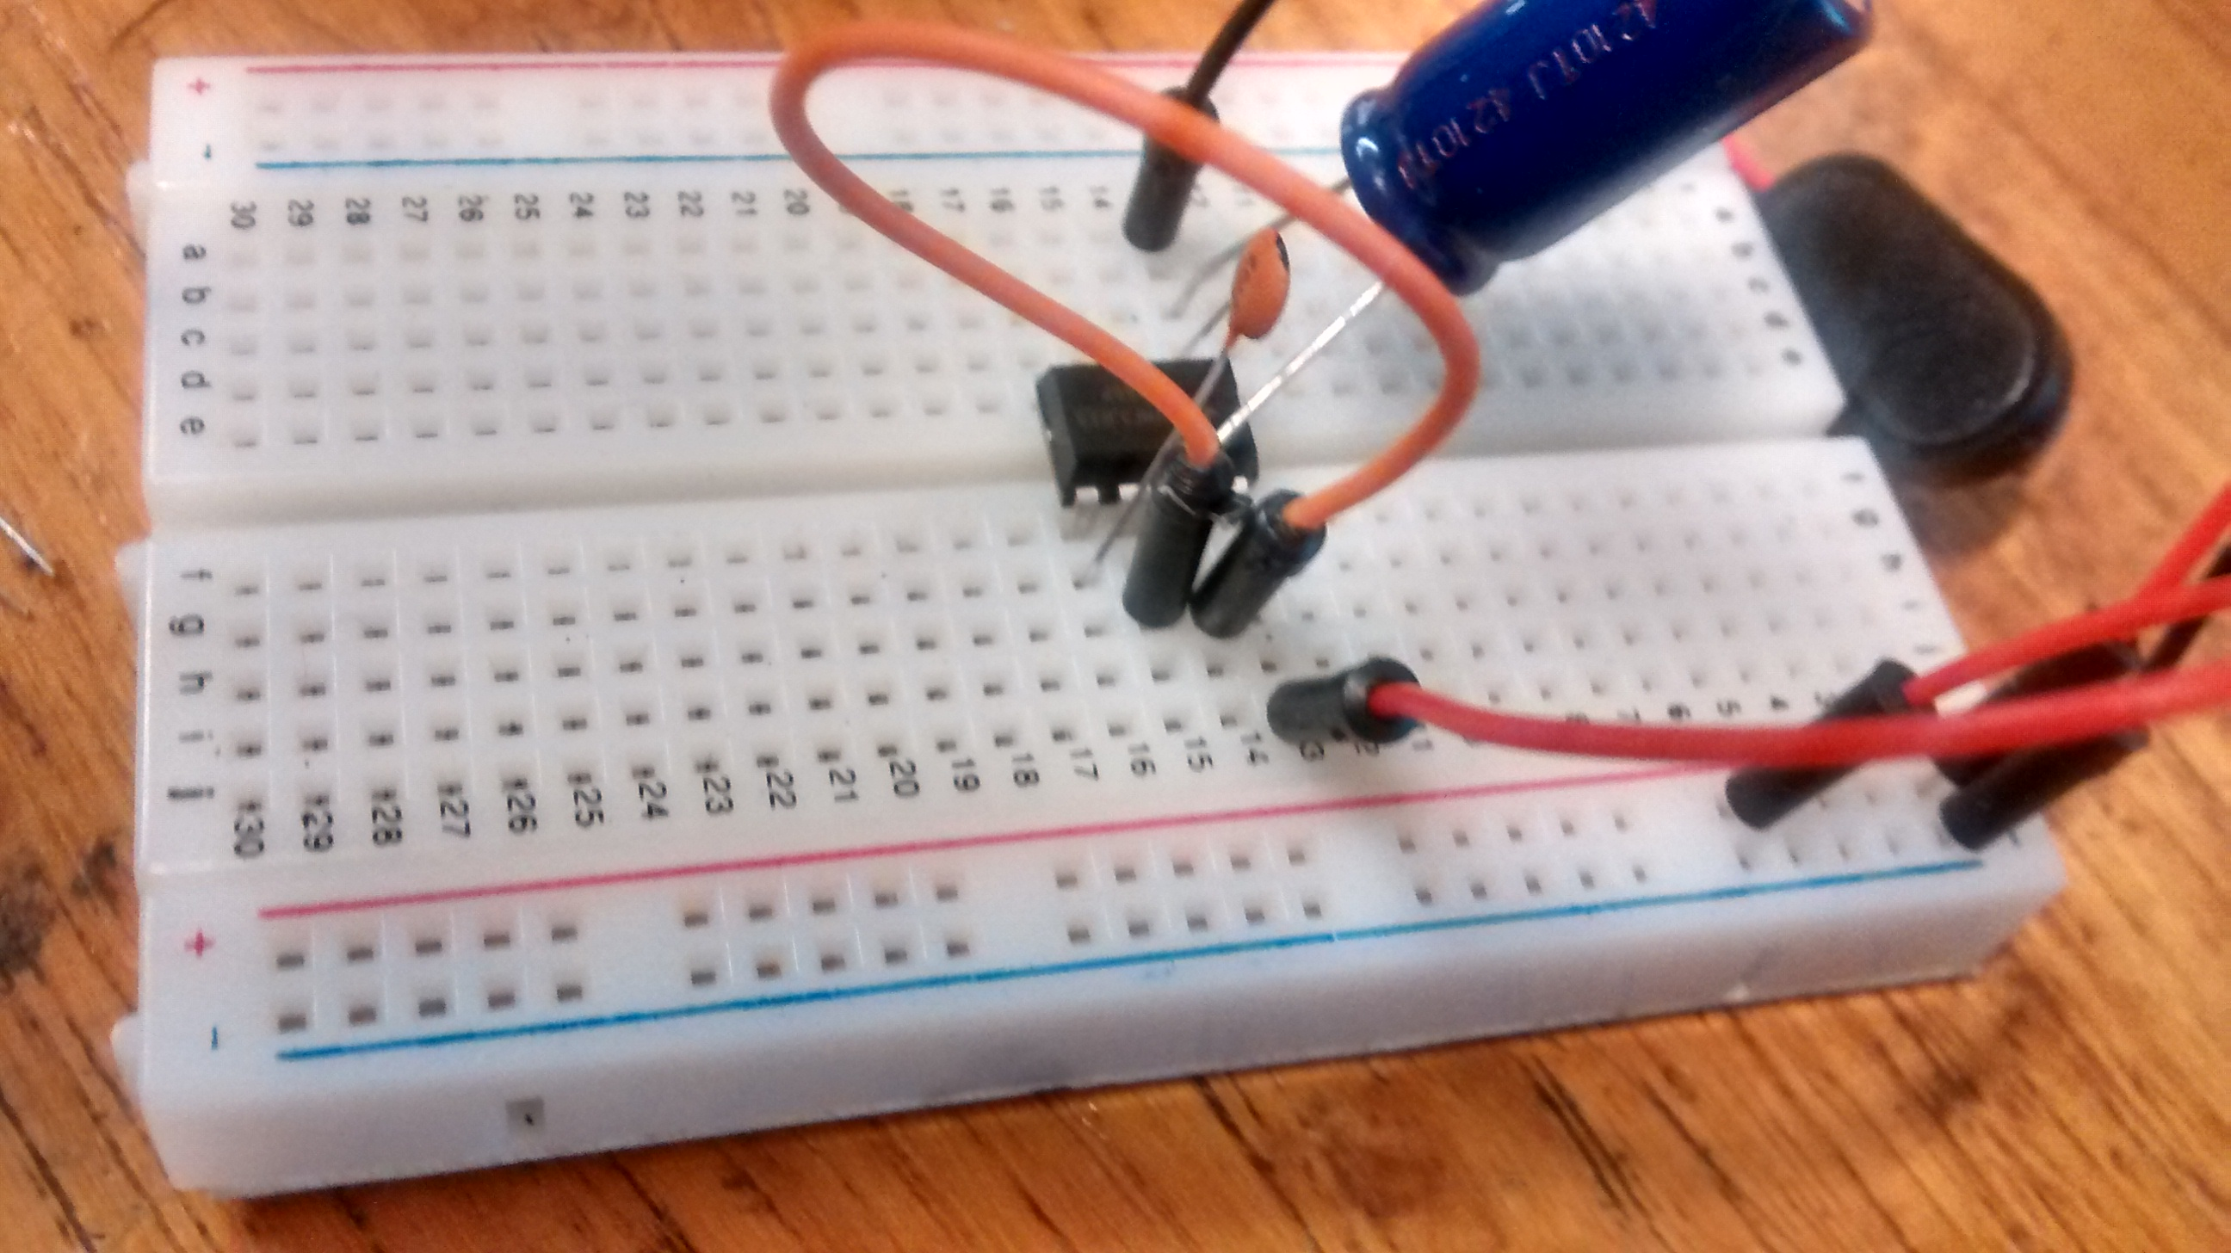
Connect pins 6 and 7 with a jumper wire

Slide 35
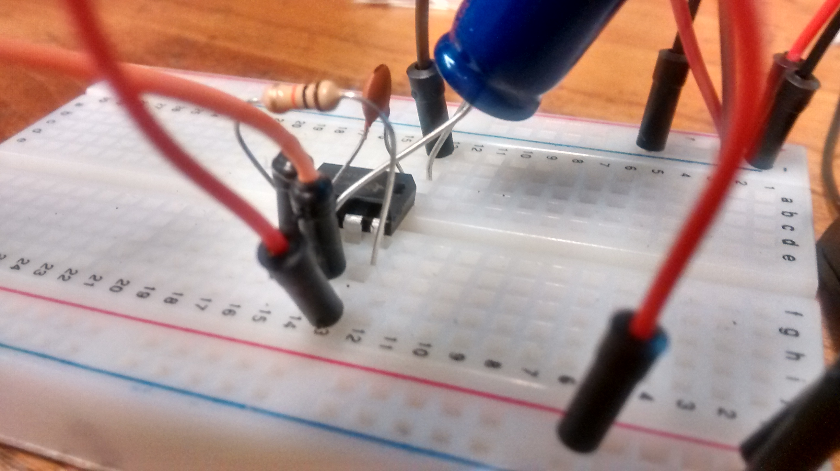
Connect a 10K resistor between pins 7 and 8

Slide 36
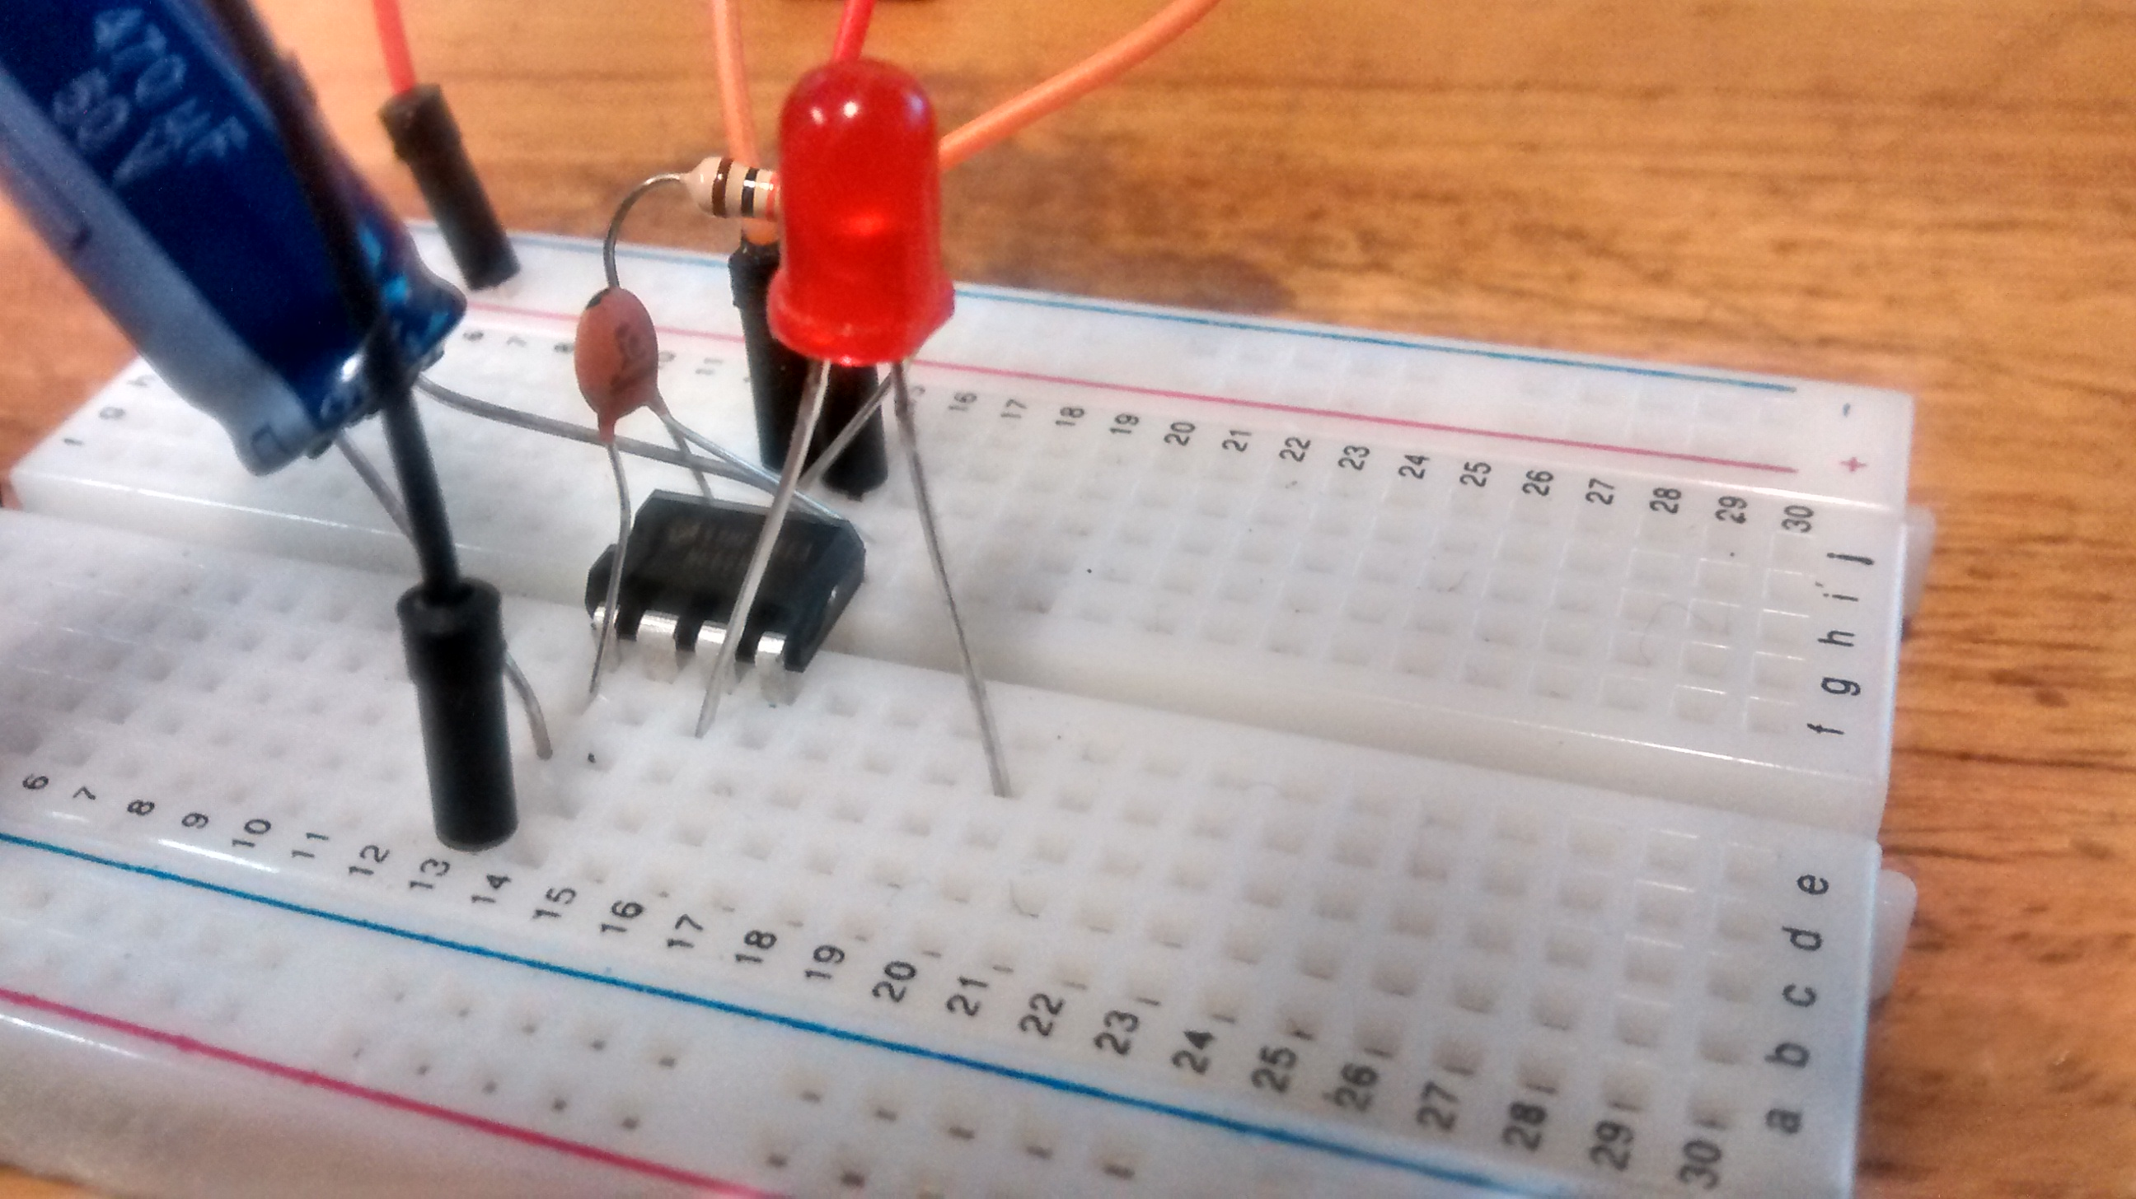
Connect a anode (+) leg of LED to output pin 3

Slide 37
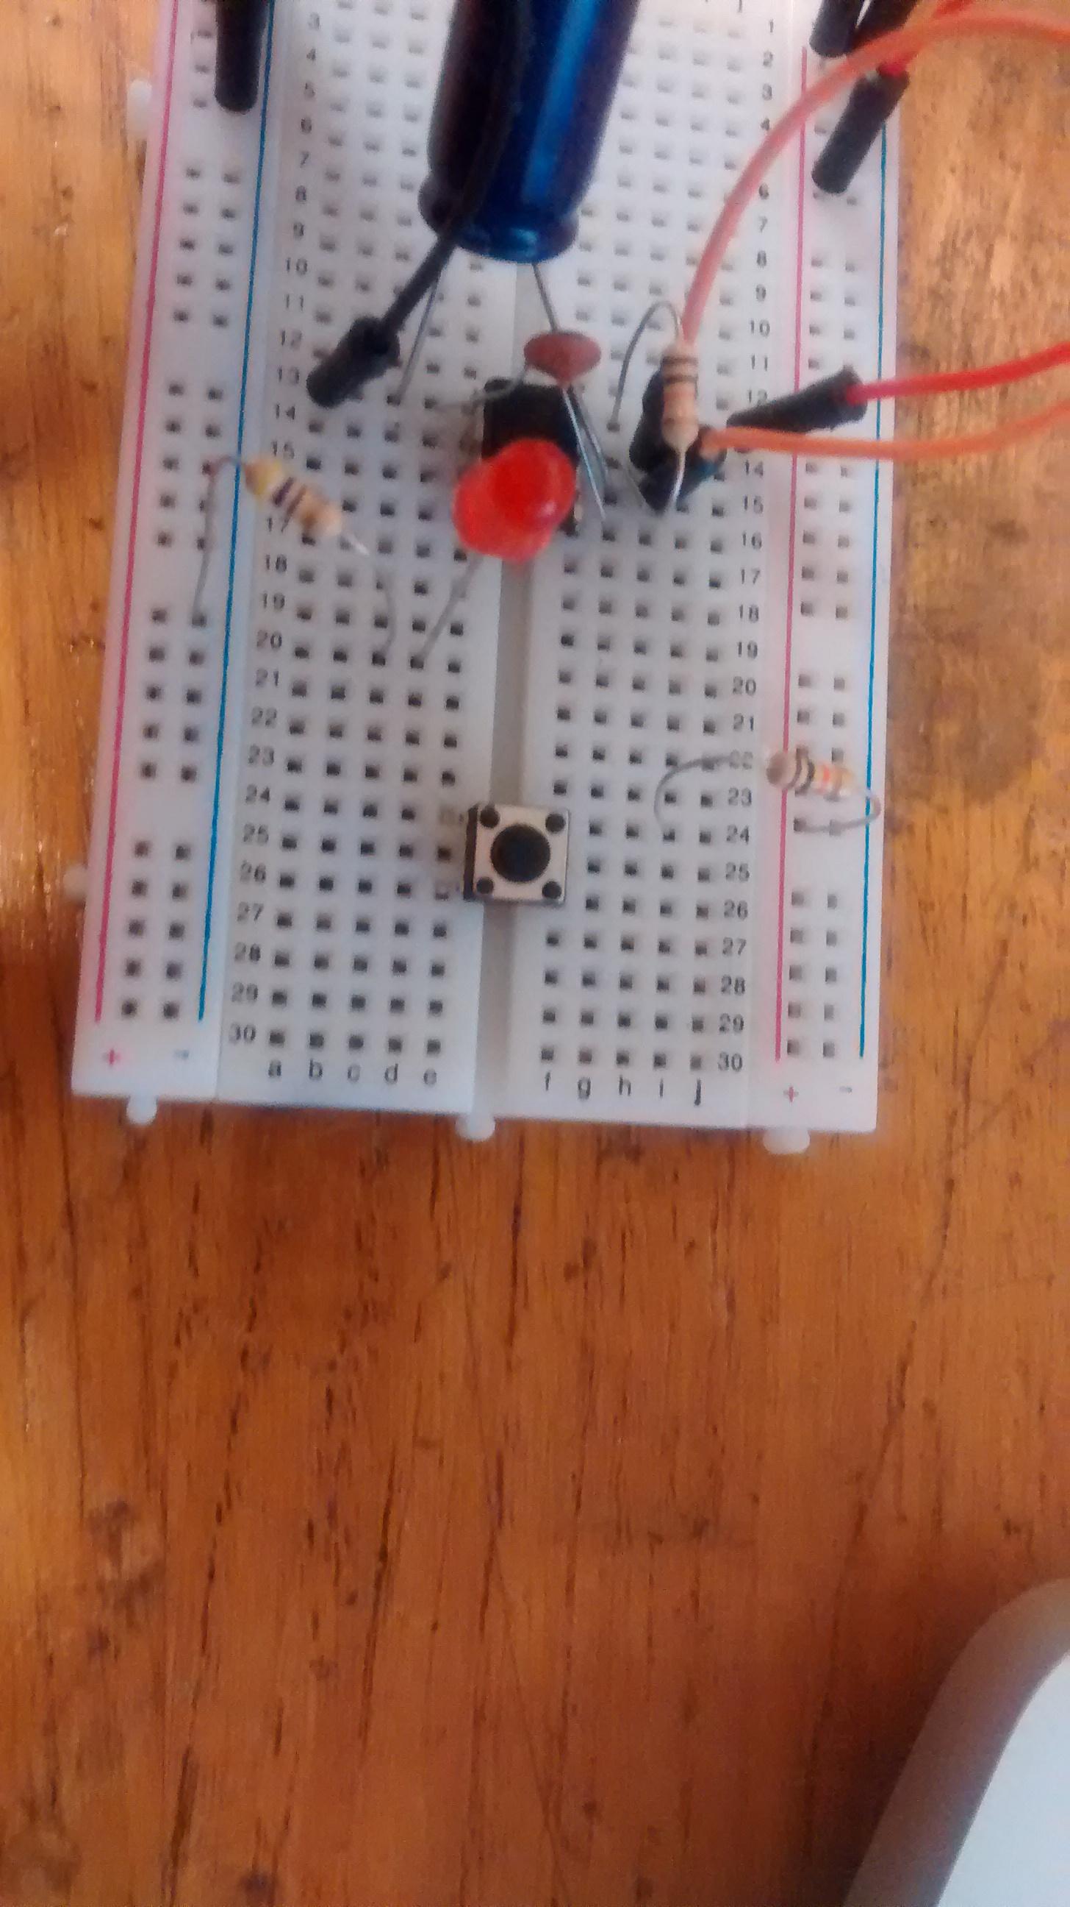
Connect a 470 resistor to LED cathode (-) leg.
Connect 470 resistor to Ground.

Slide 38
Place push button on board.
Use 10k resistor to connect one side of push button to power

Slide 39
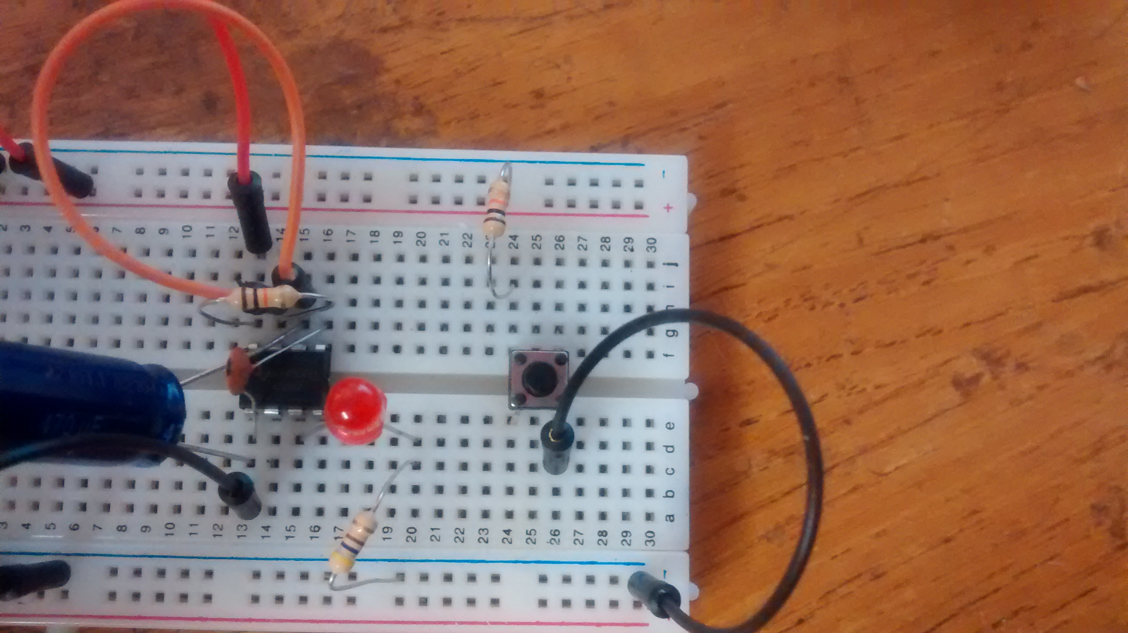
Connect other side of push button to ground.

Slide 40
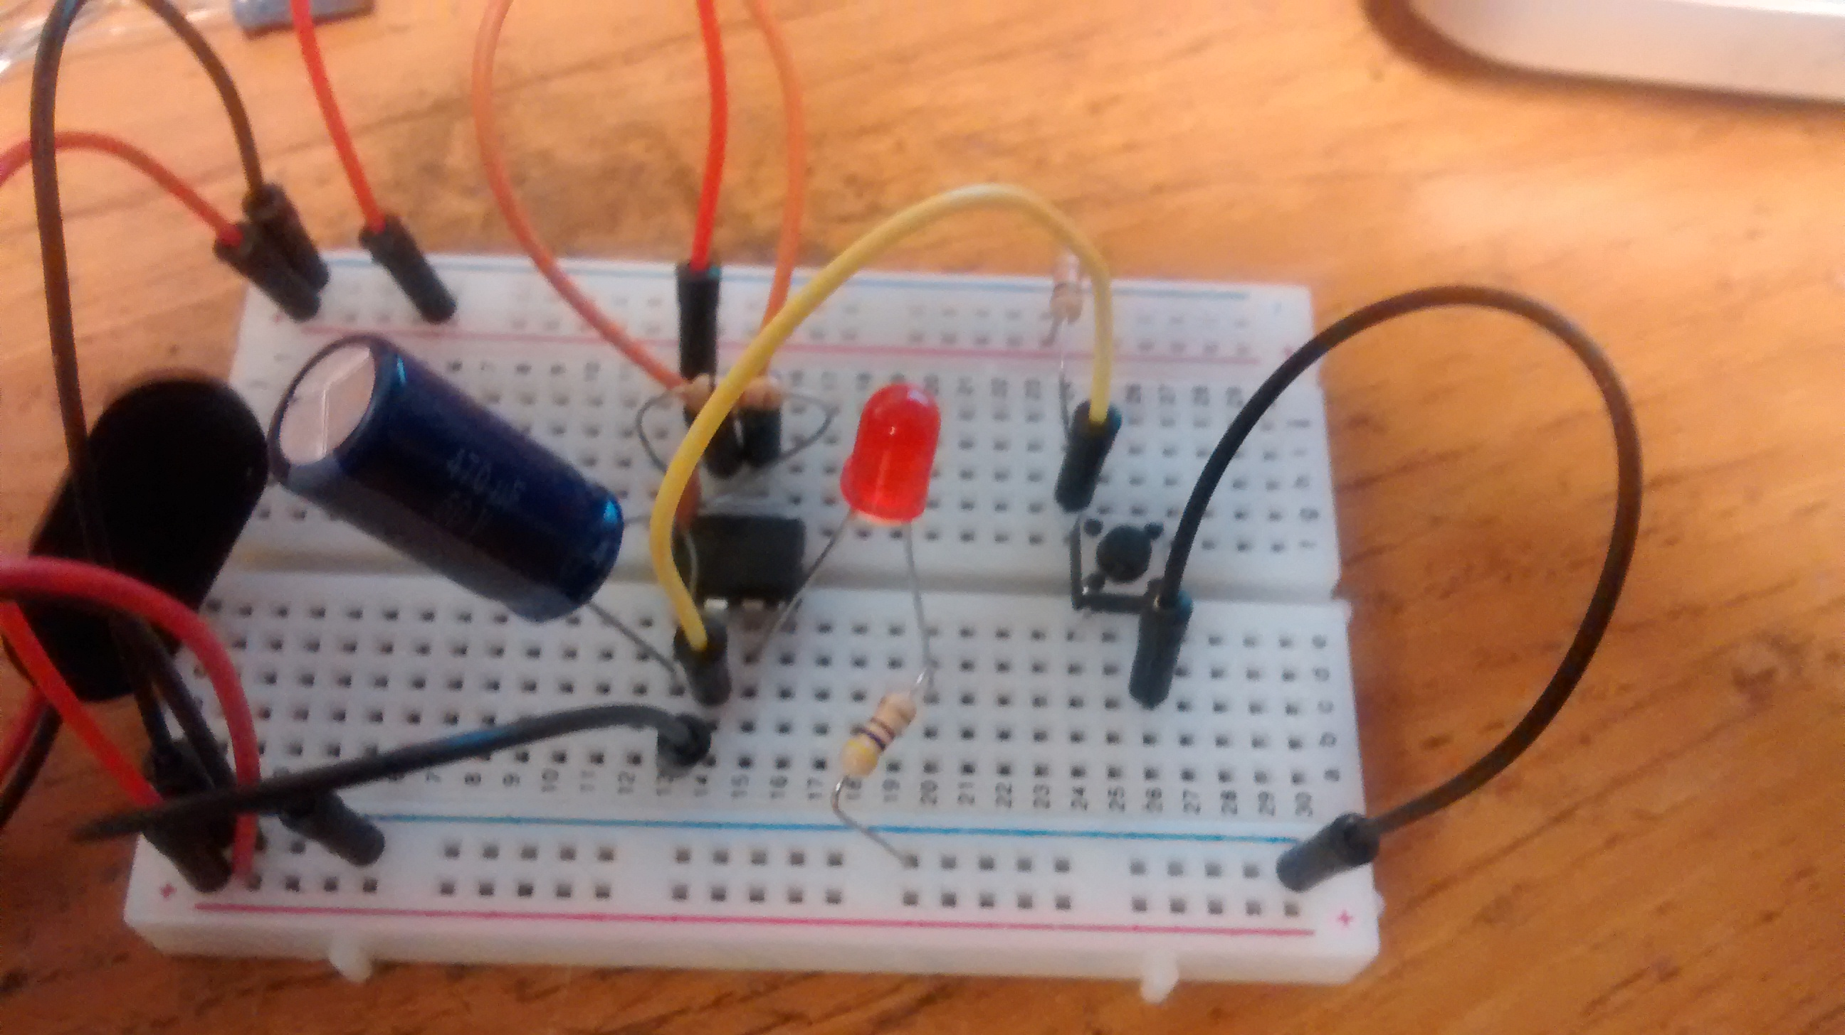
Connect a wire (yellow) from the junction between the switch and resistor to the trigger pin 2

Slide 41
Press the button. The LED should light up for a time and then turn off.
Notes:
You can experiment with switching out the 10k resistor or the 470uF capacitor (connected to the 555) to see how they affect the duration of the output pulse. Remember, since t = 1.1*R*C seconds, increasing resistance or capacitance will always increase the duration of the pulse.

Slide 42
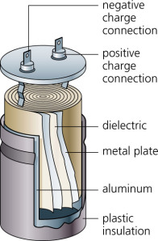
Capacitor
Notes:
How it works

Slide 43
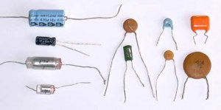
Capacitors

Slide 44
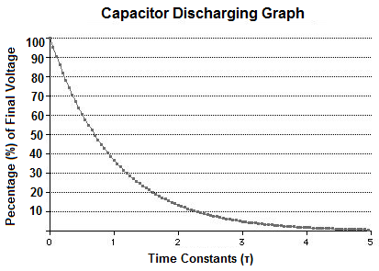
Capacitor Discharge

Slide 45
Arduino diagram1
Astable Mode Circuit
Astable Mode outputs an oscillating pulse signal/waveform.

Slide 46
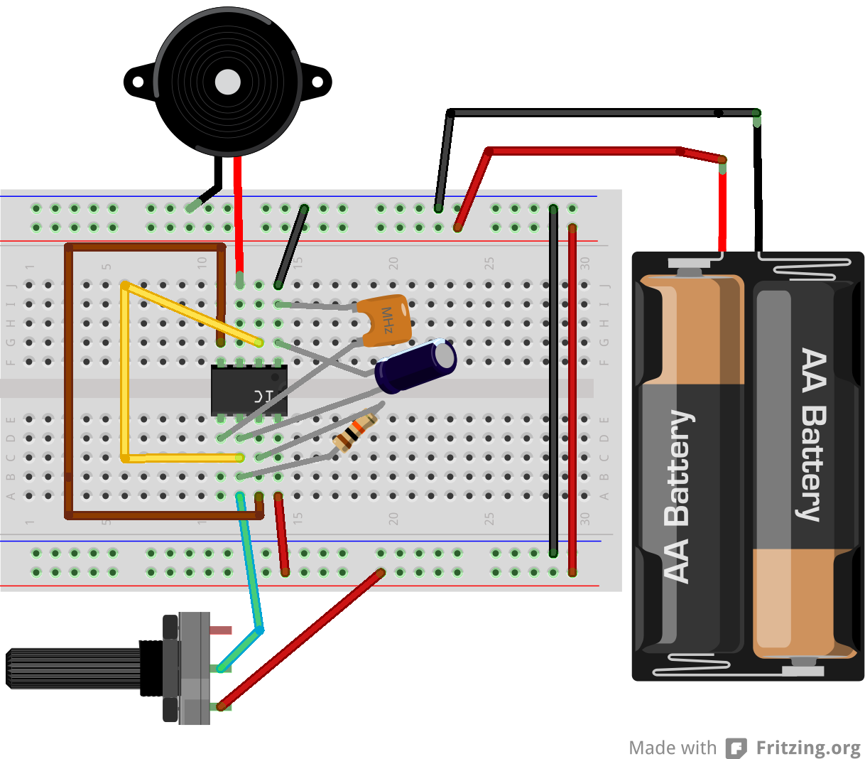
Arduino diagram1
Astable Mode Circuit

Slide 47
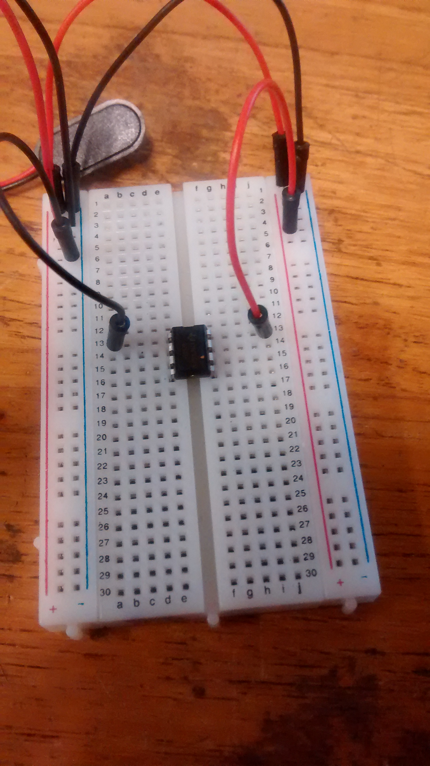
Connect power and ground to pins 8 and 1 of the 555 timer (red and black wires).

Slide 48
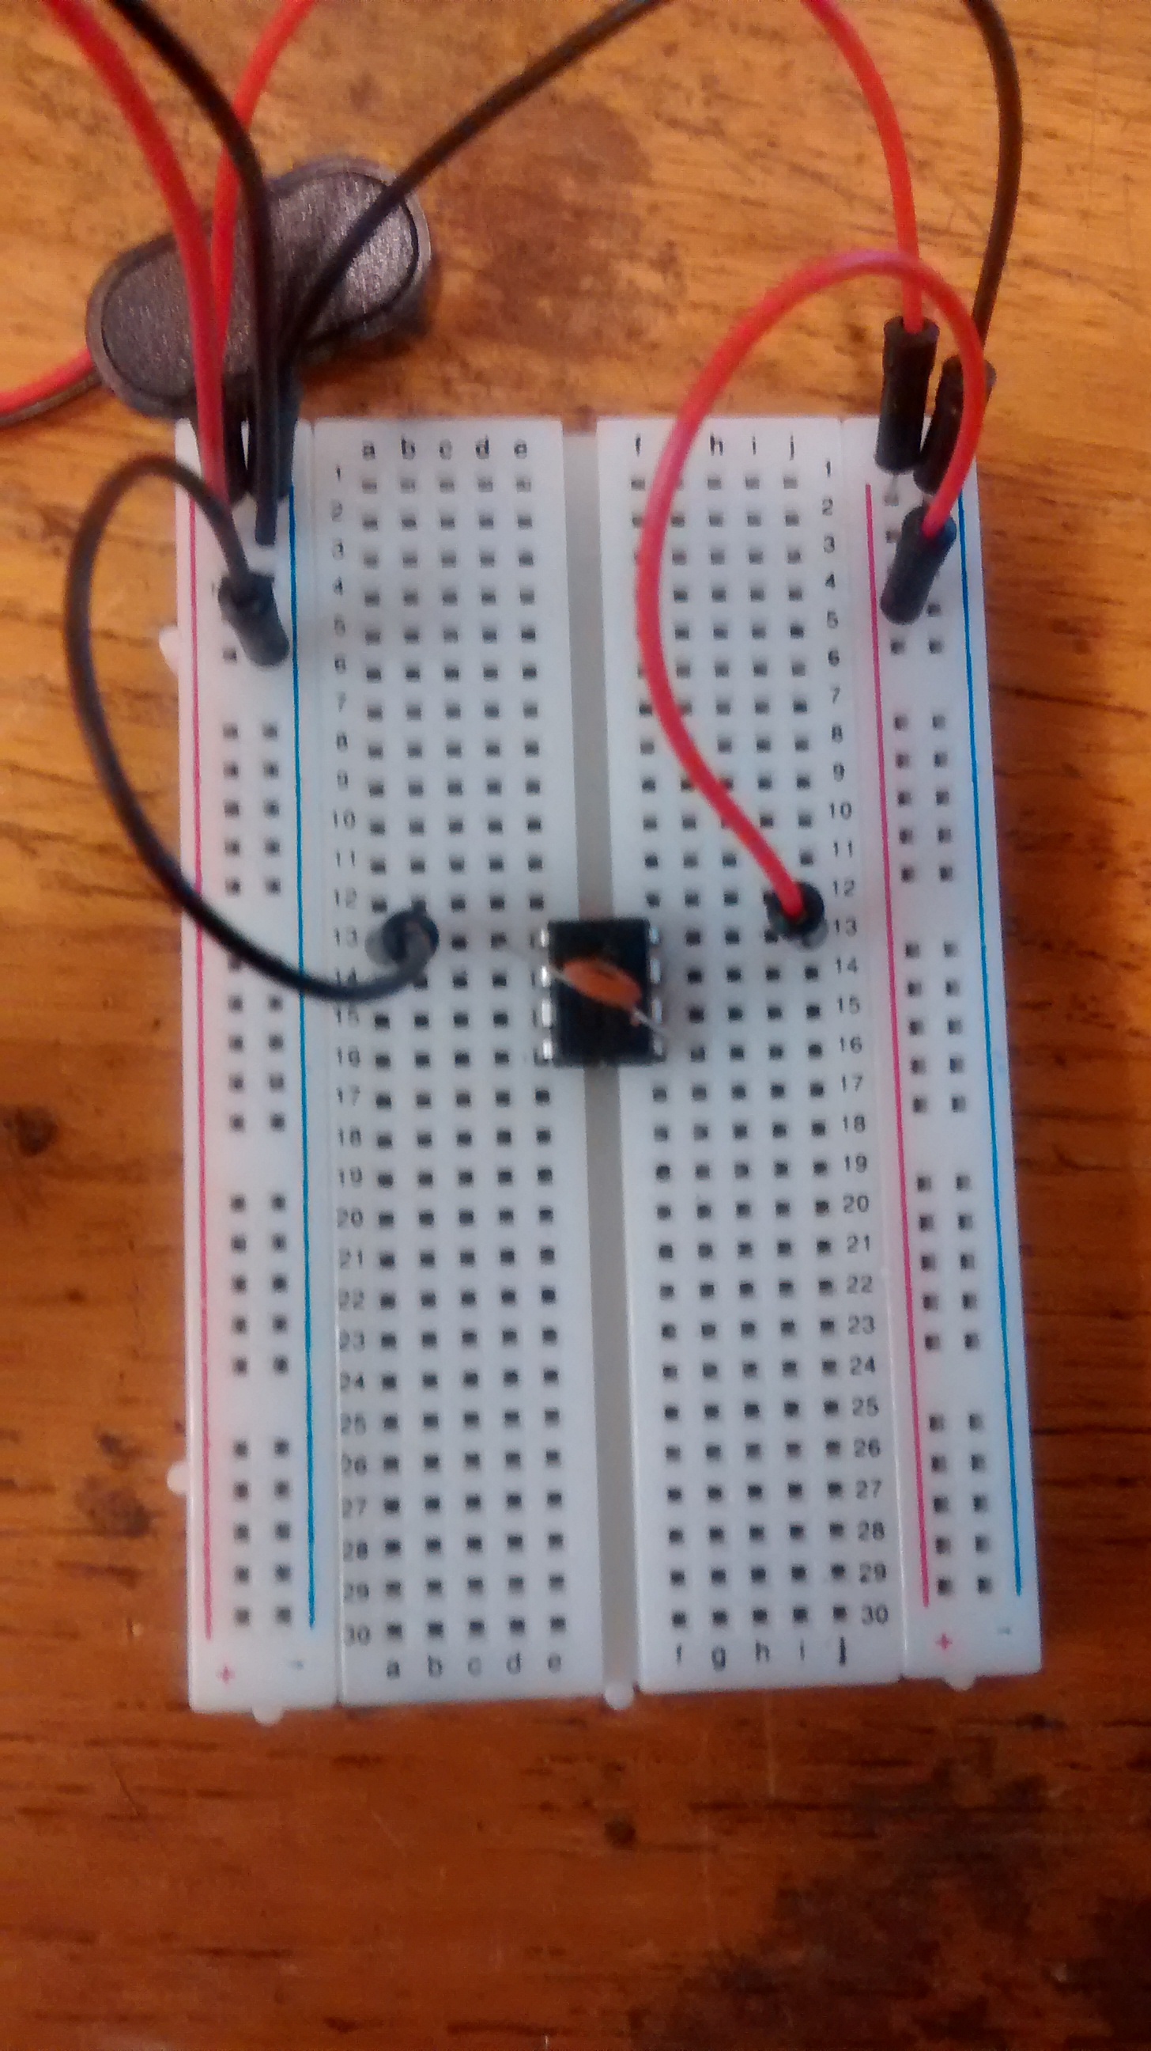
connect a 0.01uF capacitor between pins 5 and 1.

Slide 49
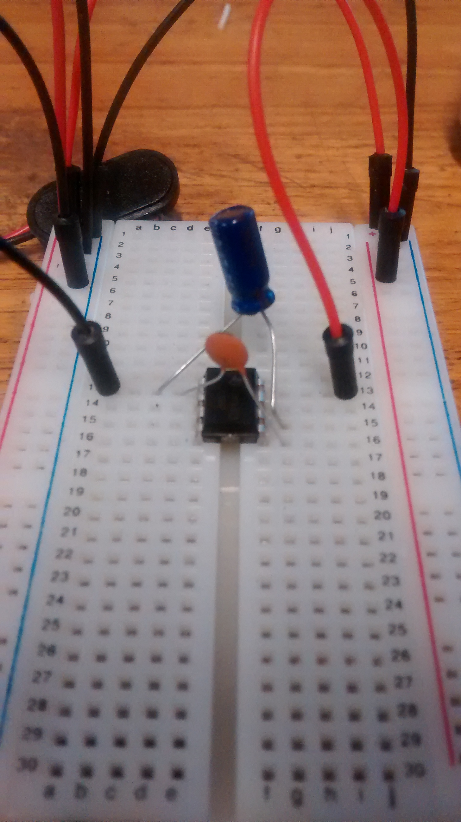
Connect a 0.47uF capacitor between pins 1 and 6, make sure that the negative lead of the capacitor is connected to pin 1

Slide 50
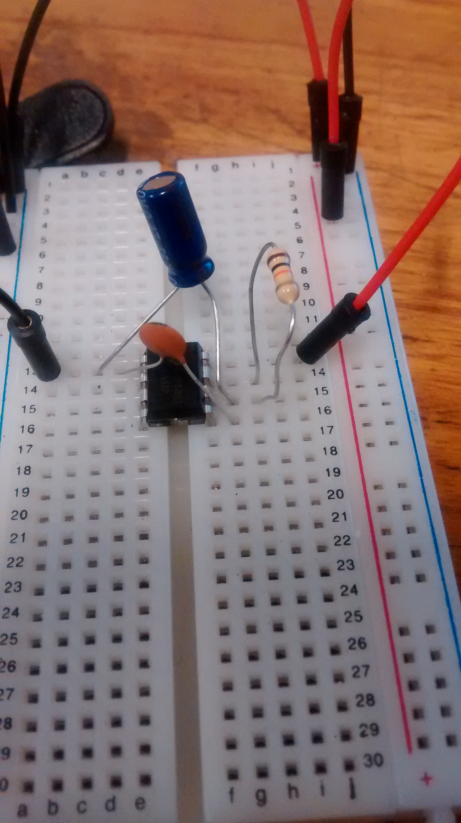
Wire a 10kohm resistor between pin 6 and 7.

Slide 51
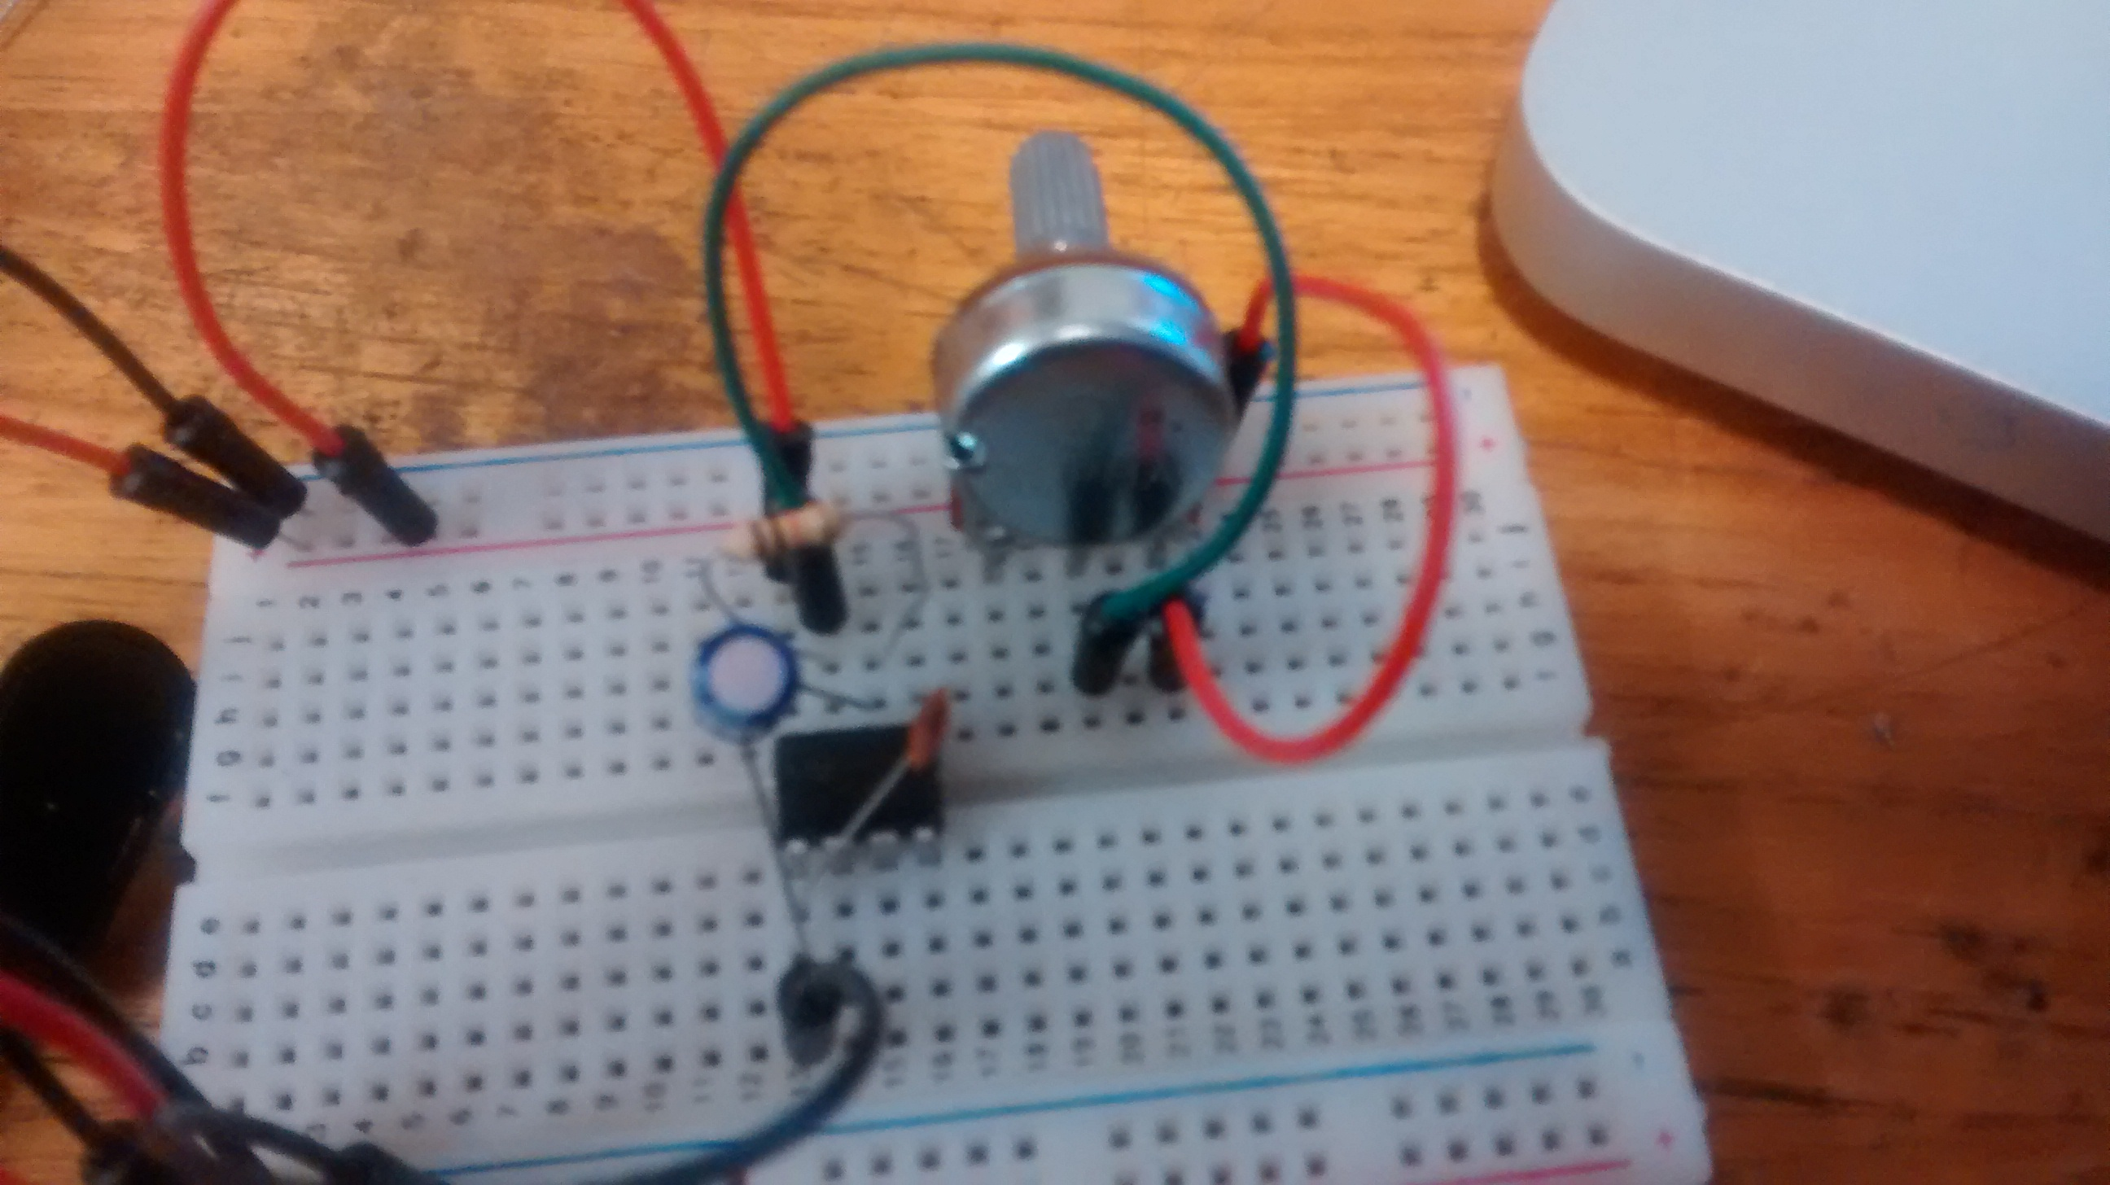
Wire a potentiometer : wire outer leg to power.
Wire center leg to pin 7

Slide 52
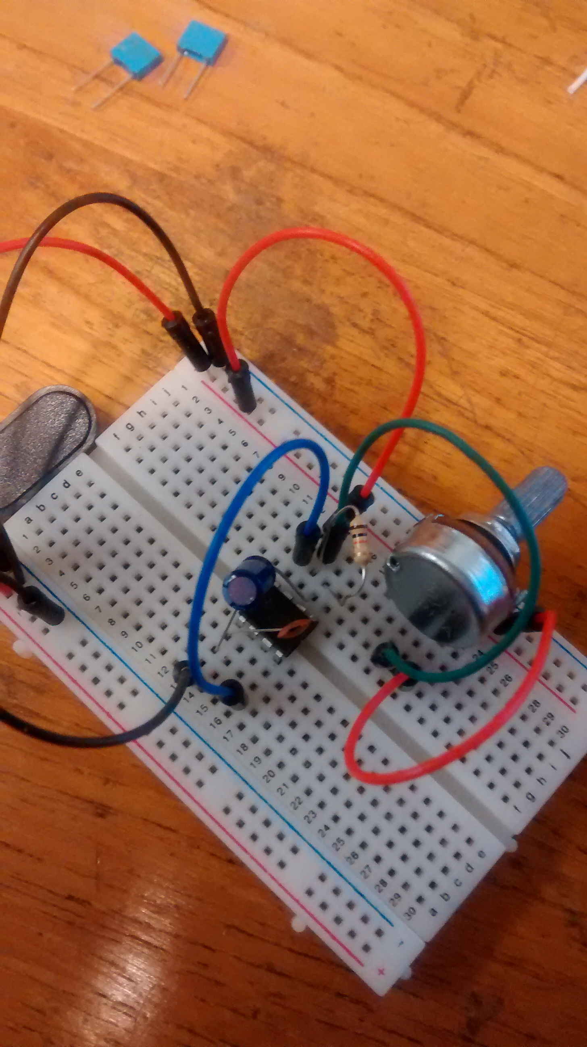
Use jumper wire to connect pins 4 and 8 to each other (blue)

Slide 53
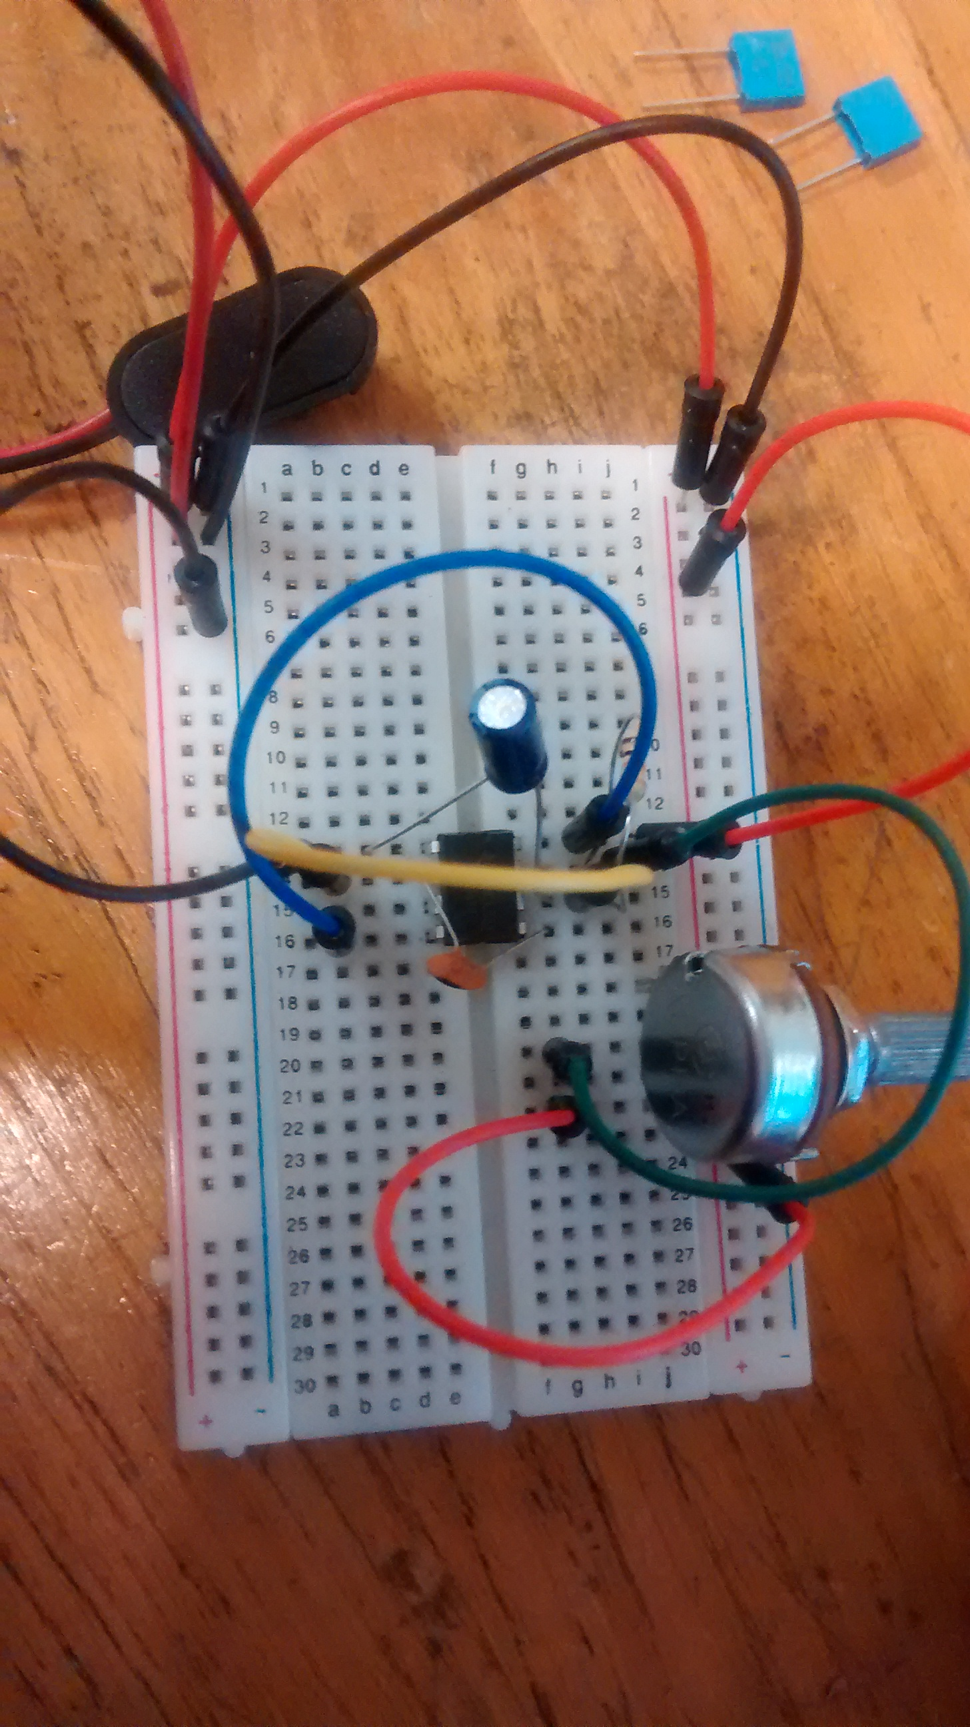
Use jumper wire to connect pins 2 and 6 to each other (yellow)

Slide 54
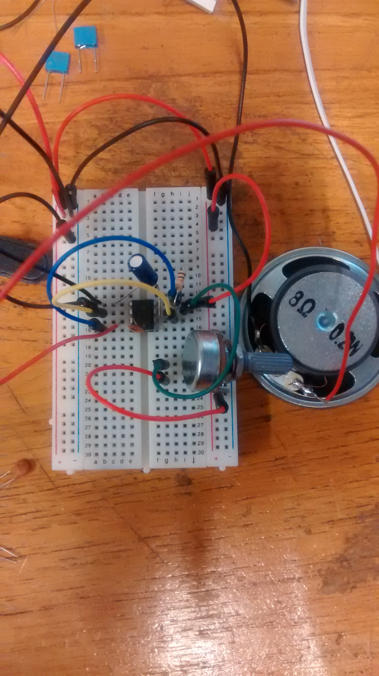
Attach the positive lead of a speaker to pin 3 of the 555 timer
connect the negative lead to ground (pin 1).

Slide 55
When you power this circuit you should begin to hear the pulse waveform coming from the 555.
Turn the potentiometer to change the frequency of this pulse wave.

Slide 57
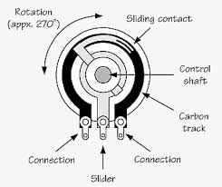
Potentiometer as variable resistor

Slide 58
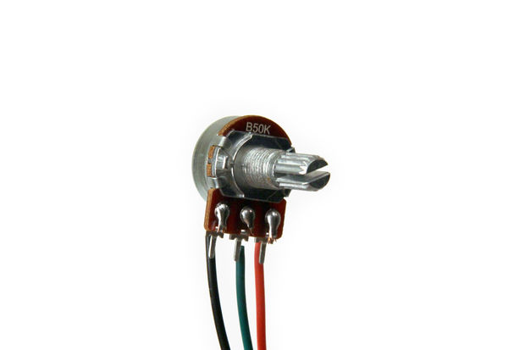
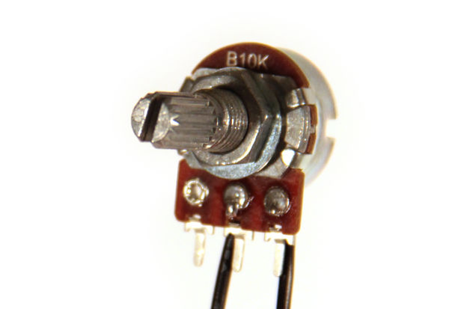
Potentiometer as variable resistor
Voltage Divider
Variable Resistor
Notes:
Normally, potentiometers are wired as variable voltage dividers: connect +V to one side, connect the other side to ground, and the middle pin will output a voltage between 0 and +V (fig 2).
by only connecting two pins (one outside pin and one center pin) of a potentiometer to your circuit, you can turn a pot into a variable resistor.
a B label means it is a linear taper pot. This means the resistance of the material inside the pot is uniform for all positions of the knob.
A label on it it has a logarithmic taper: the resistive material inside the pot is not uniform.

Slide 59
Arduino diagram1
Variable Resistor
Notes:
Pencil variable resistor

Slide 60
Arduino diagram1
Pulse waveform
The 555 timer is a chip that can be used to create pulses of various durations

Slide 61
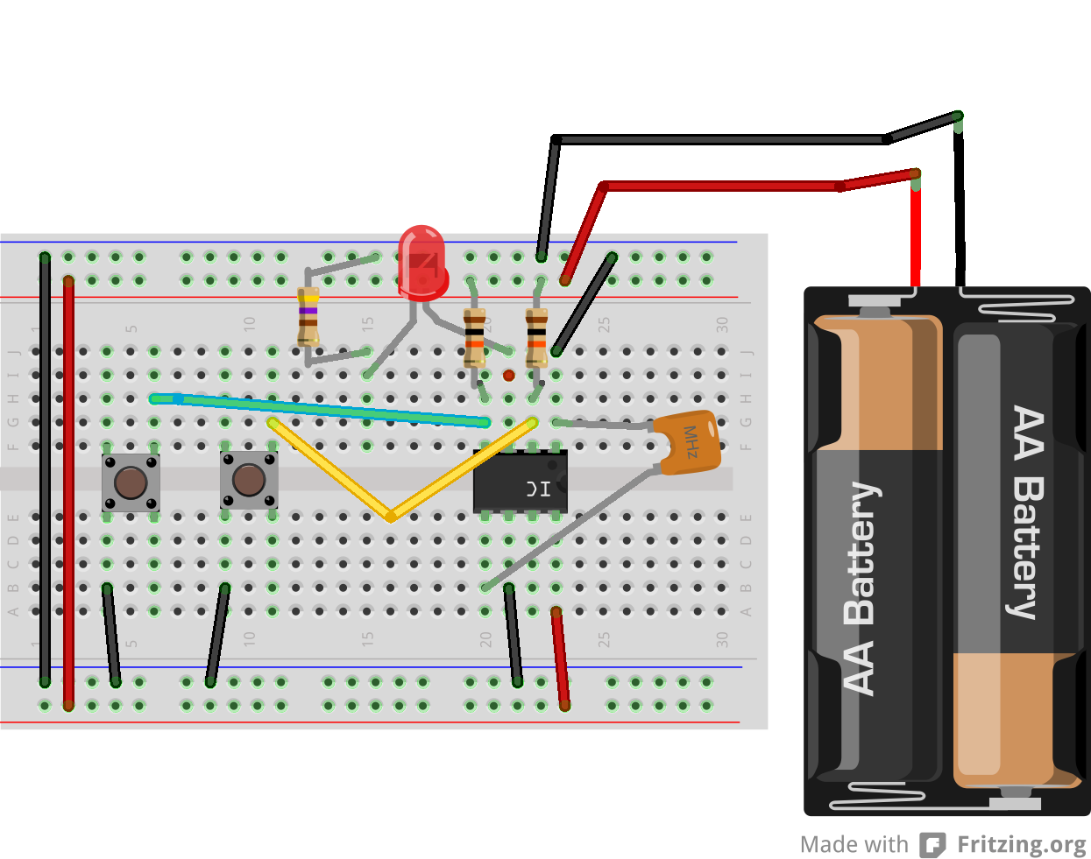
Bistable Mode Circuit
Notes:
Press the button attached to pin 2 (trigger). The LED should light up, indicating that the output is now in a high state. Release the trigger button, the LED will remain lit. Now press the reset button, this will cause the output to go low and turn the LED off. Release the reset button, the LED should remain off. Now you have created a circuit that toggles between two stable states based on which button was last pressed

Slide 62
Connect power and ground to pins 8 and 1 of the 555 timer (red and black wires).

Slide 63
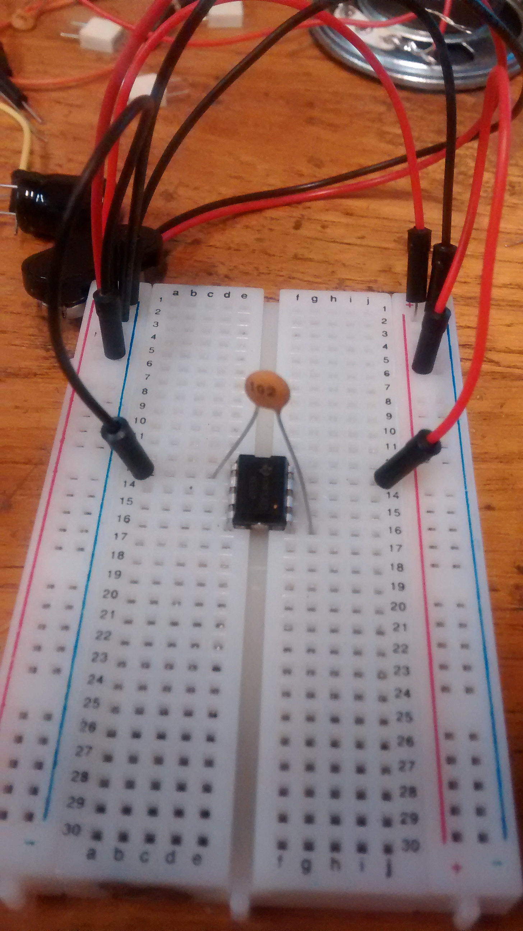
connect a 0.01uF capacitor between pins 5 and 1.

Slide 64
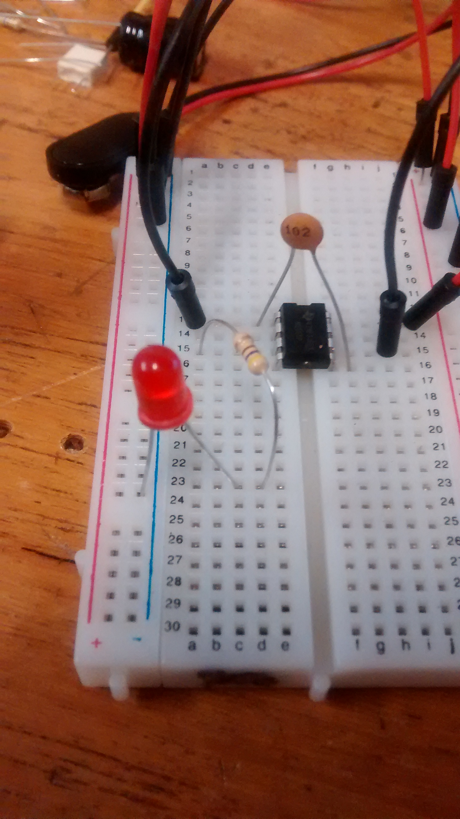
Connect pin 6 to ground.

Slide 65
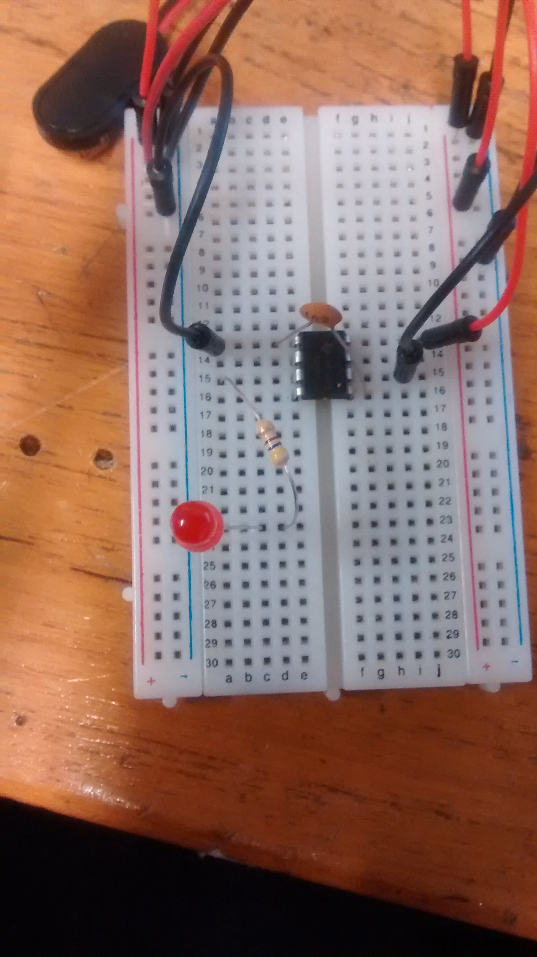
Connect resistor to pin 3 and LED (+) to resistor then connect to ground

Slide 66
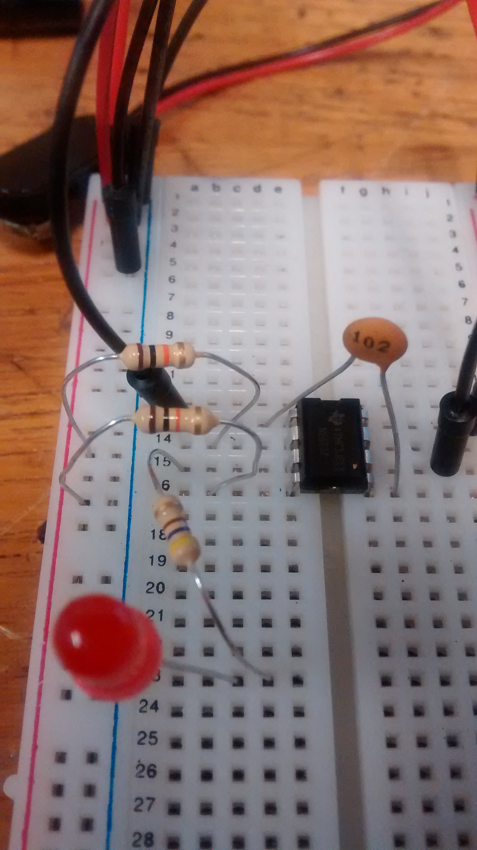
Wire a 10Kohm resistor between pin 4 and Power (red)

Slide 67
Wire a 10Kohm resistor pin 2 and Red (Vcc).

Slide 68
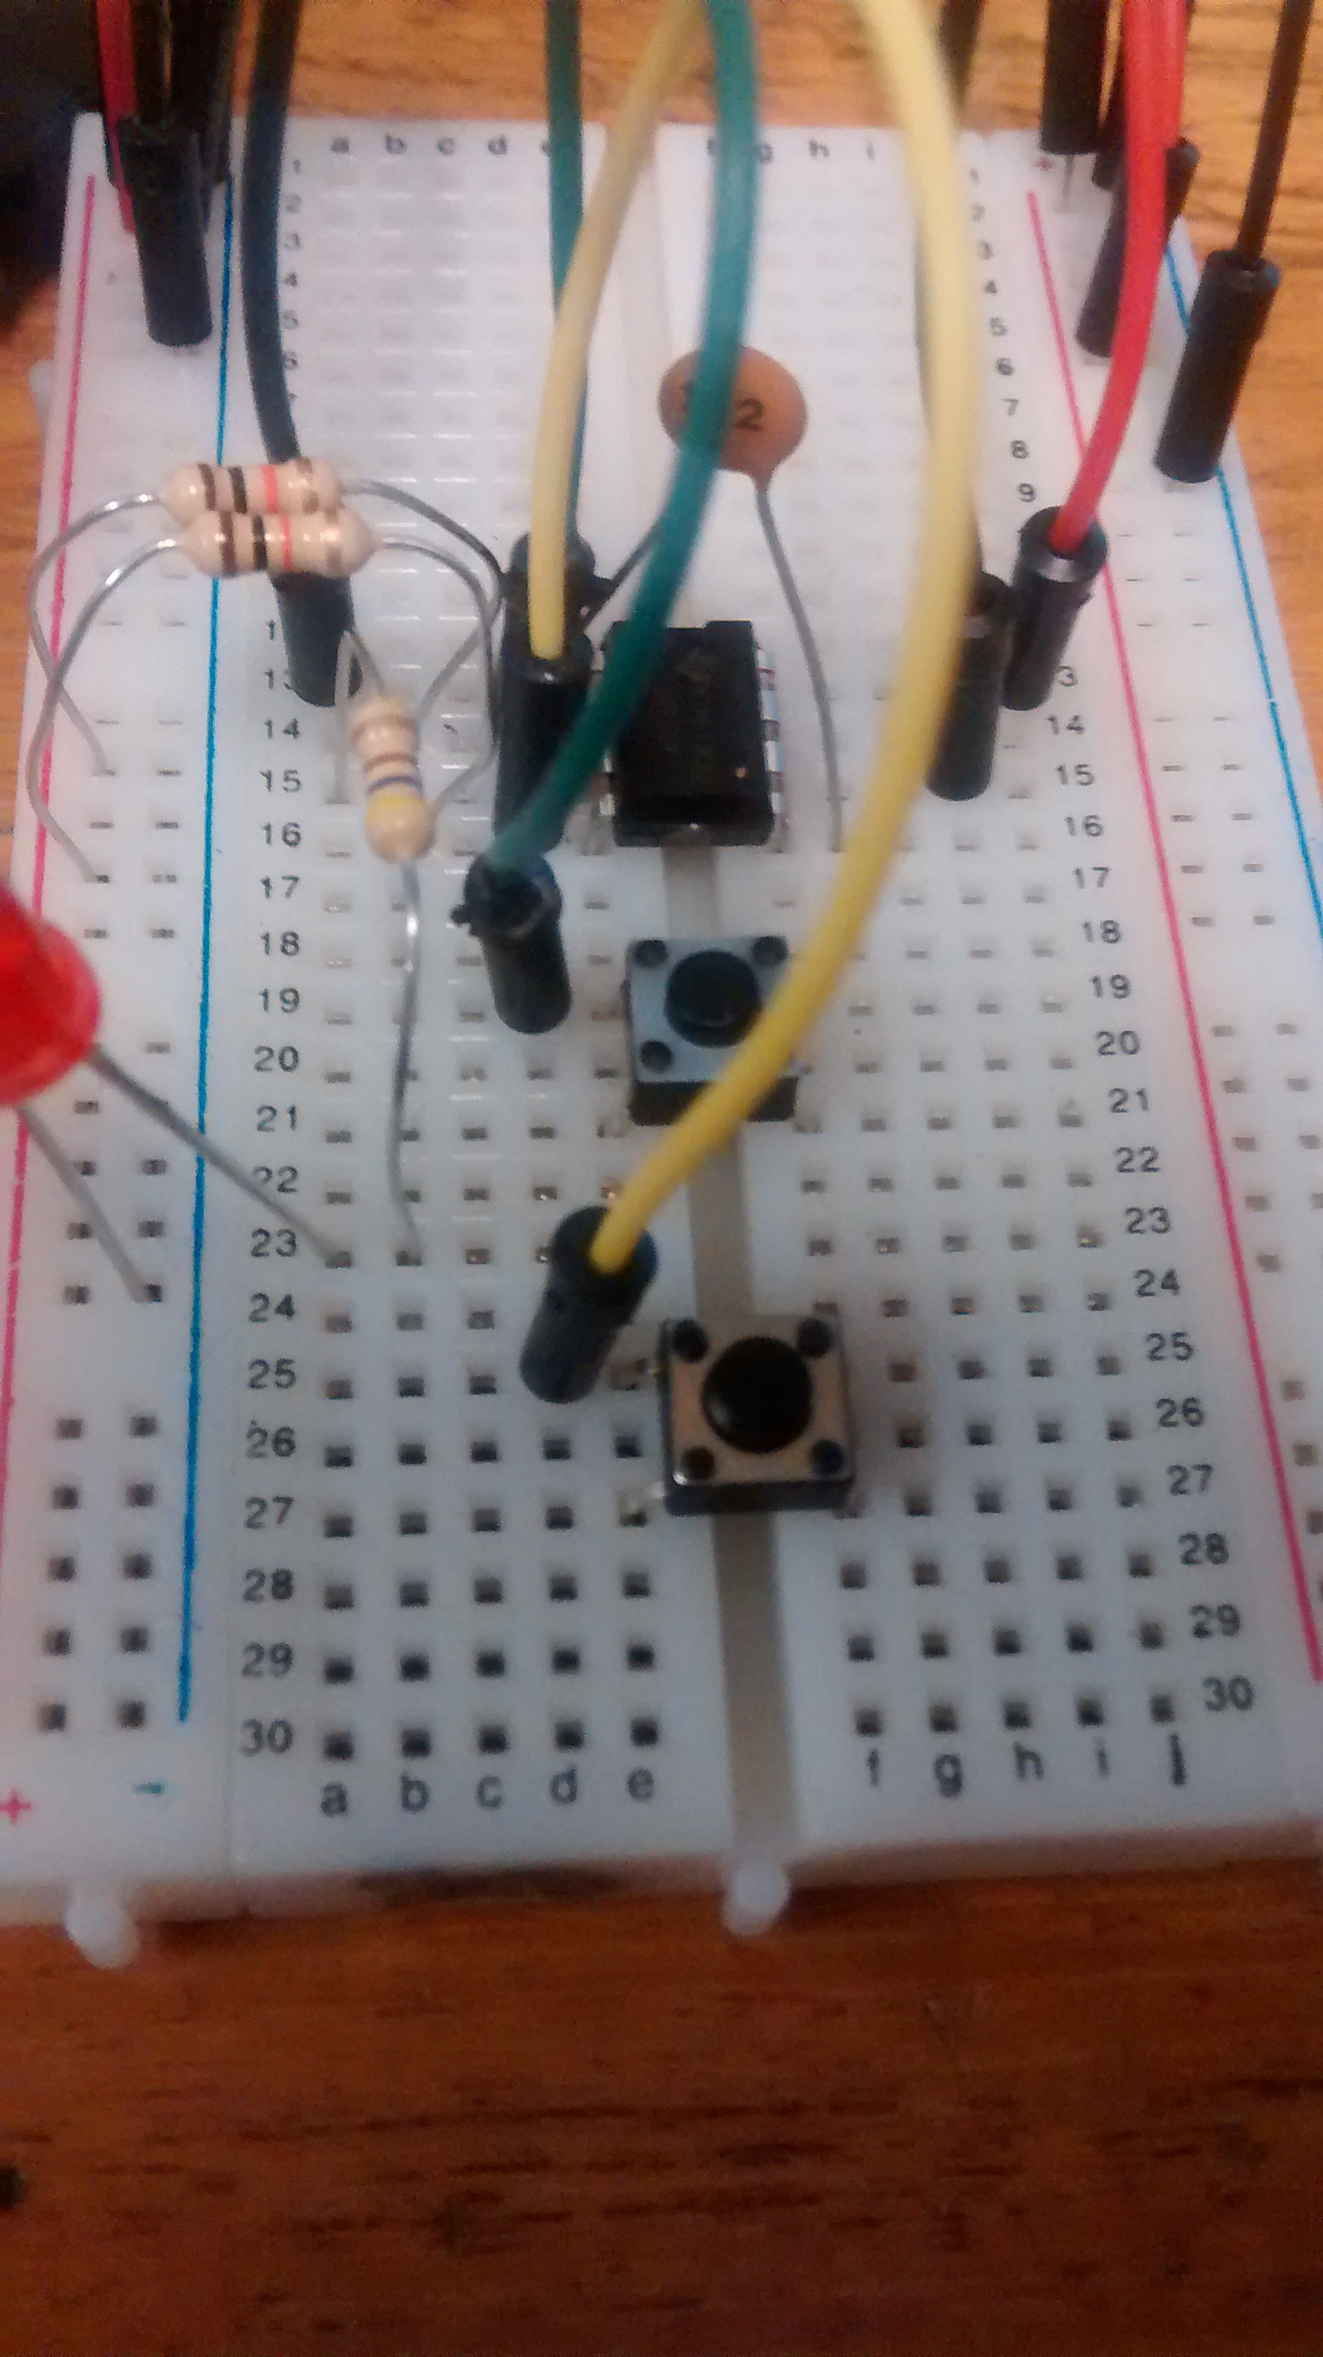
Place two push buttons on the board

Slide 69
Button A – wire to pin 2
Button B - wire to pin 4

Slide 70

Button A – opposite side to ground (black)
Button B - opposite side to ground (black)

Slide 71

Press the button attached to pin 2 (trigger). = The LED should light up = high state
Now press the pin 4 (reset button) = this will cause the output to go low and turn the LED off.
Now you have created a circuit that toggles between two stable states based on which button was last pressed.

